Slide 1

Advanced Manufactoring Sector
Regional exemples
19 – O3- 2025

Slide 2

Regional Example : Belgium - Flanders
Annick Haesaerts – GO! Education of the Flemish Community

Slide 3
Agenda
Belgium - Flanders
Description of the labor market in Belgium
Problems in labor market
Challenges – solutions
Projects

Slide 4
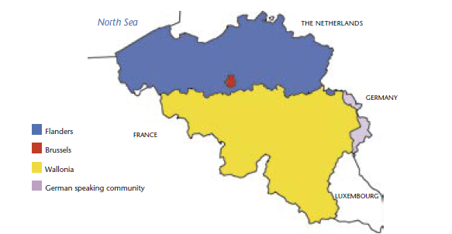

Slide 5
Description Labor Market
General
11.8 millions inhabitants
    6.8 millions Flanders
    3.7 millions Wallonia
    1.25 millions Brussels Capital Region
Main Industries :
Pharmaceutical industry (20,4%)
Food anbd Drink industry (15,4%)
Chemical Industry (15%)
Manufacture of primary metals and metal production (11%)

Slide 6
Description Labor Market
Manufacturing industry Belgium
87 billion € added value
573,000 jobs (11% total working population)
Jobs :
  Electronics
  Plastics/synthetic materials processing
  Mechanical engineering
  Metal products
  Textiles
  Transport equipment

Slide 7
Description Labor Market
Problems
Jobs not filled in
Labor Market mismatch
Rapid technological tranformation and digital revolution

Slide 8
Description Labor Market
Challenges
Activation
Finding and retaining qualified people
Forming people with competences of future
Attracting young people to engineering and technology professions

Slide 9
Description Labor Market
solutions
Revalue technical and vocational education
Companies : academies + training programs
Reginal Technology Centers in every Province
Attracting young people to engineering and technology professions

Slide 10
3 rd stage (5+ 6 grade → programme = 2 years
Domaine | Finality Flow to higher education |  | Double Finality (higher education or labour market) | Labour market finality
STEM
cross-domain economics-mathematics science-mathematics …. | domain-specific technological sciences and engineering Mechatronics bio-technological and chemical STEM sciences …… |  | automotive techniques building techniques industrial ICT wood techniques aircraft techniques … | bicycle installations cooling installations welding-construction truck-driver Building construction site machinist …..
Biotechnological and chemical sciences

Slide 11
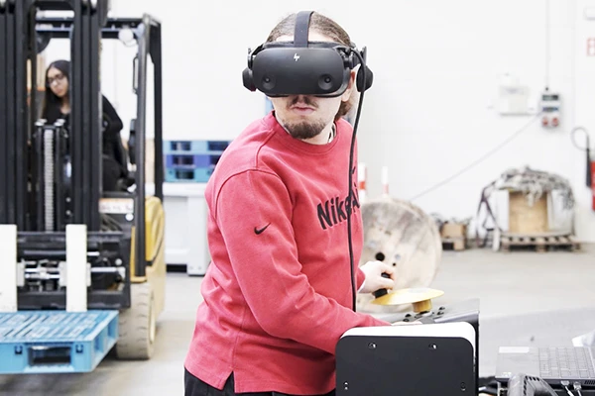
Example : project 1
Forklift abnd reach truck driving program
Collabaration GO! – Adecco’s Workforce Academy 4.0

Slide 12
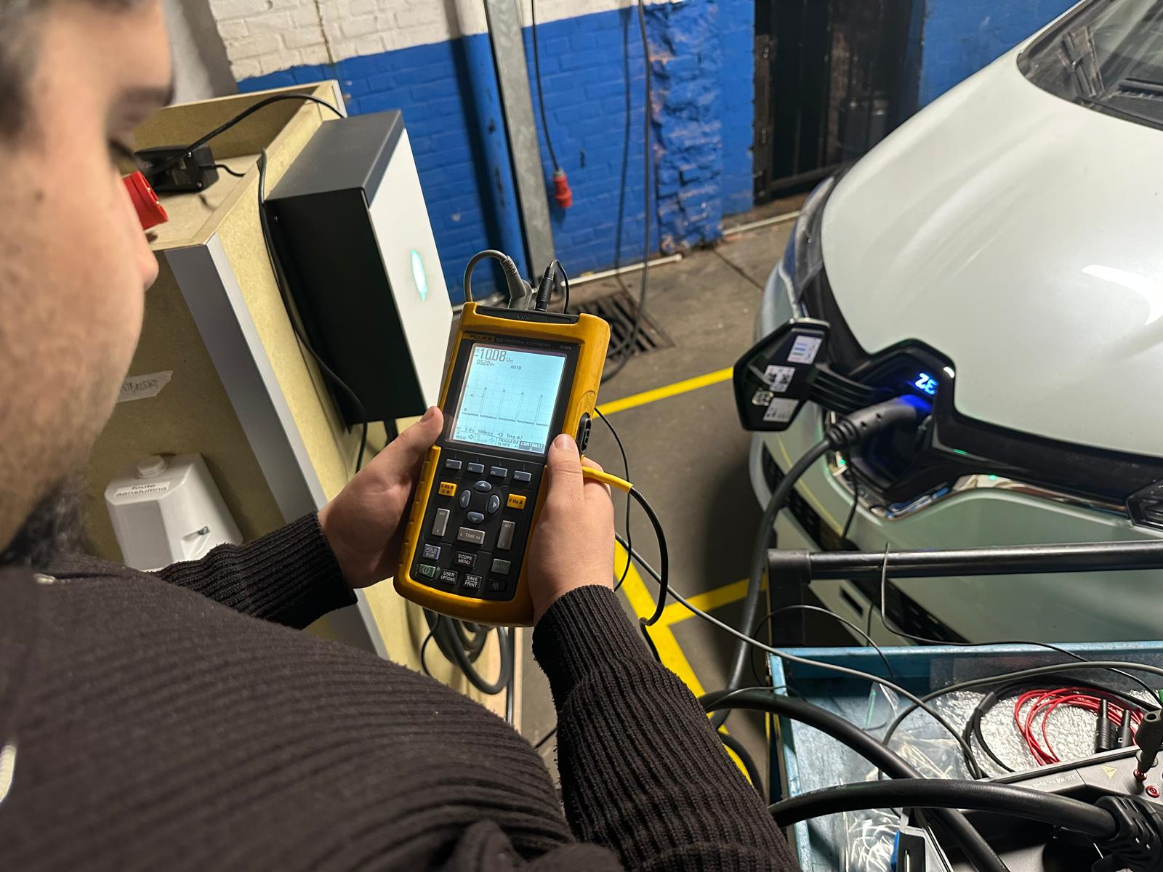
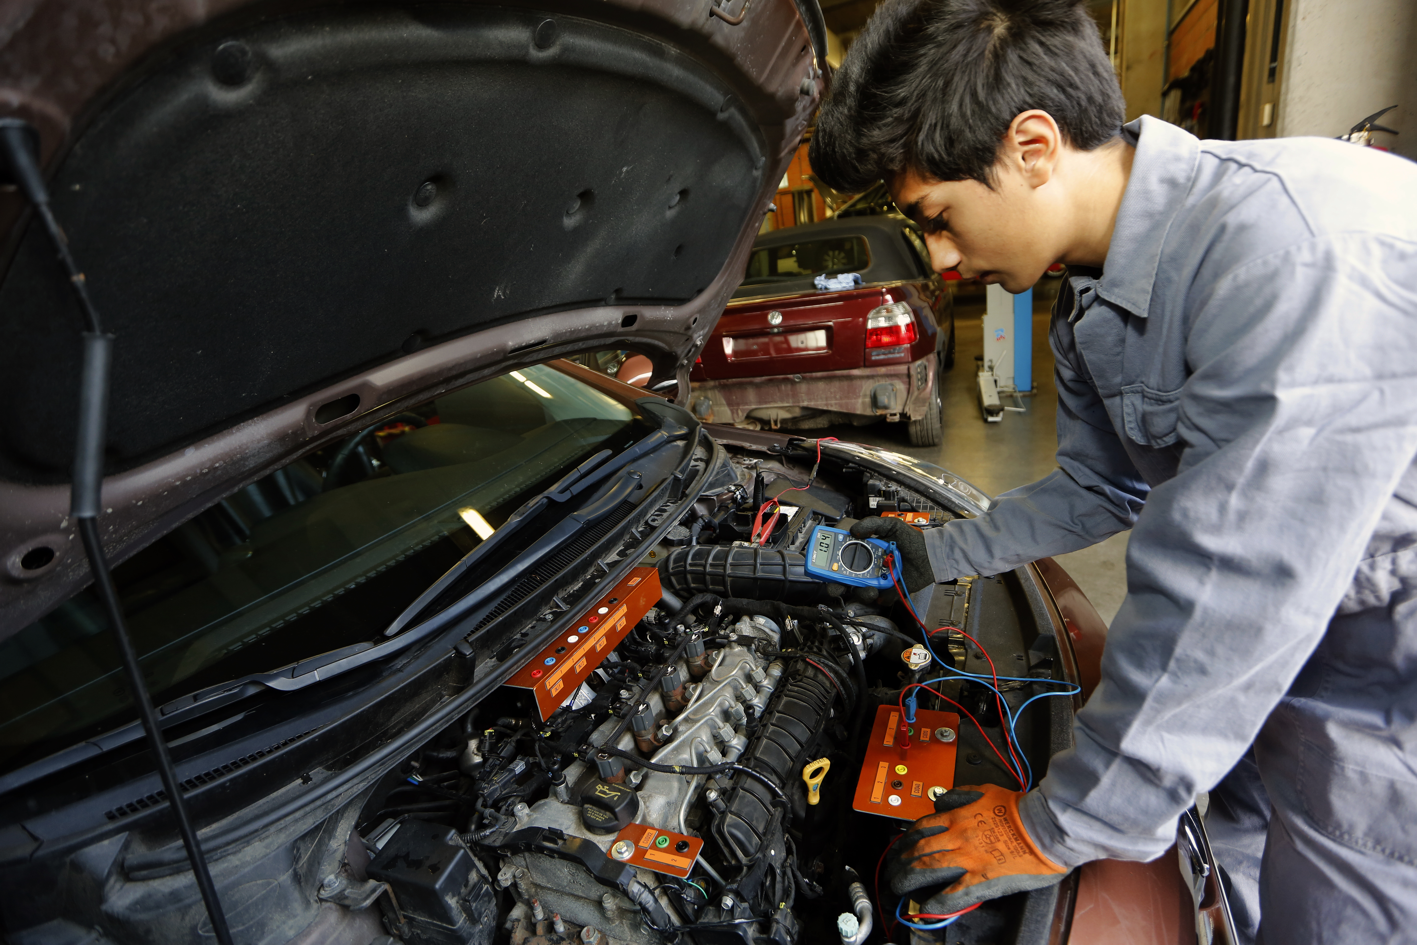
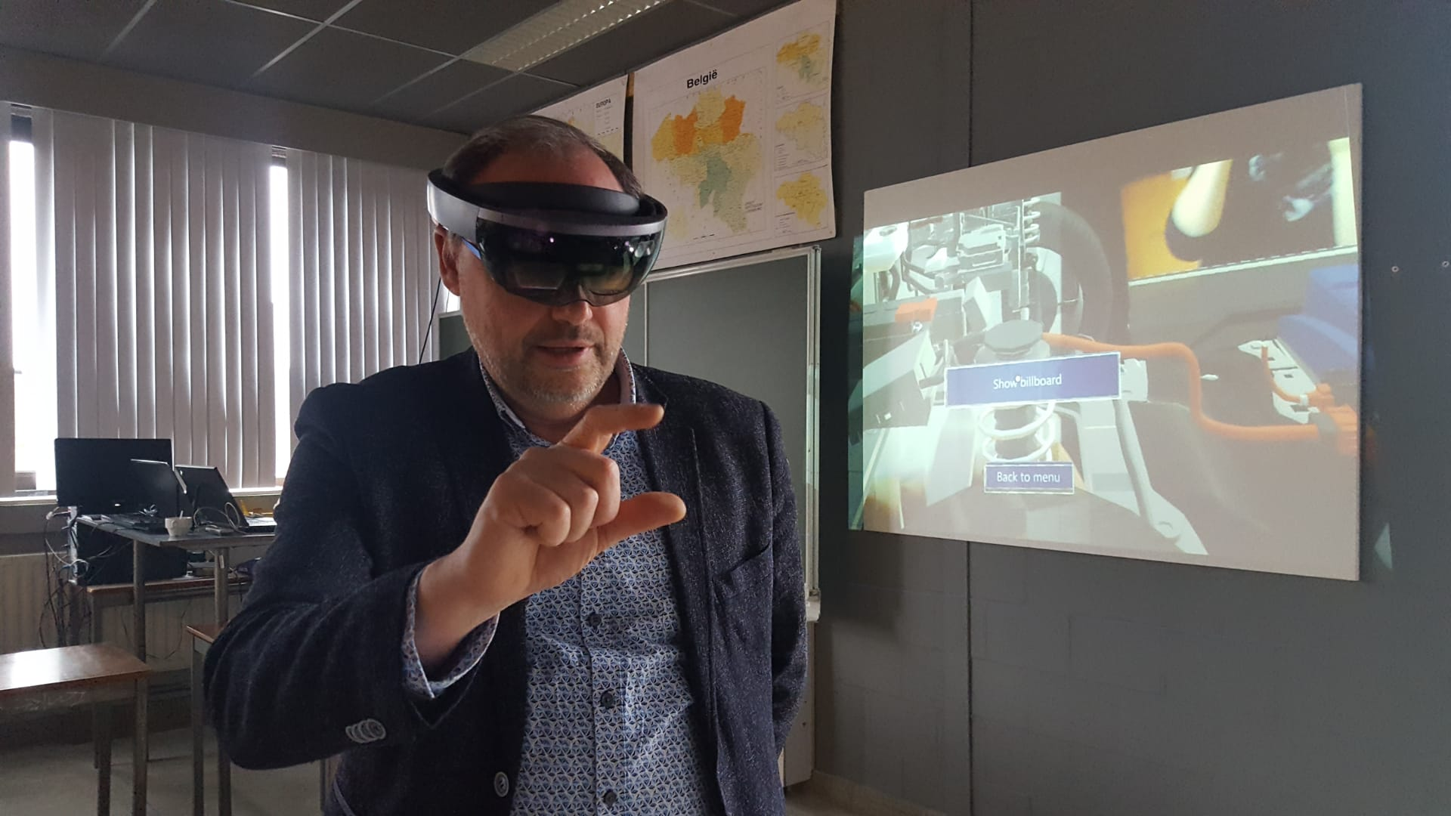
Example : project 2
Training with modern technology in automotive sector
Collabaration GO! – Connectief – Diagnose Car

Slide 13
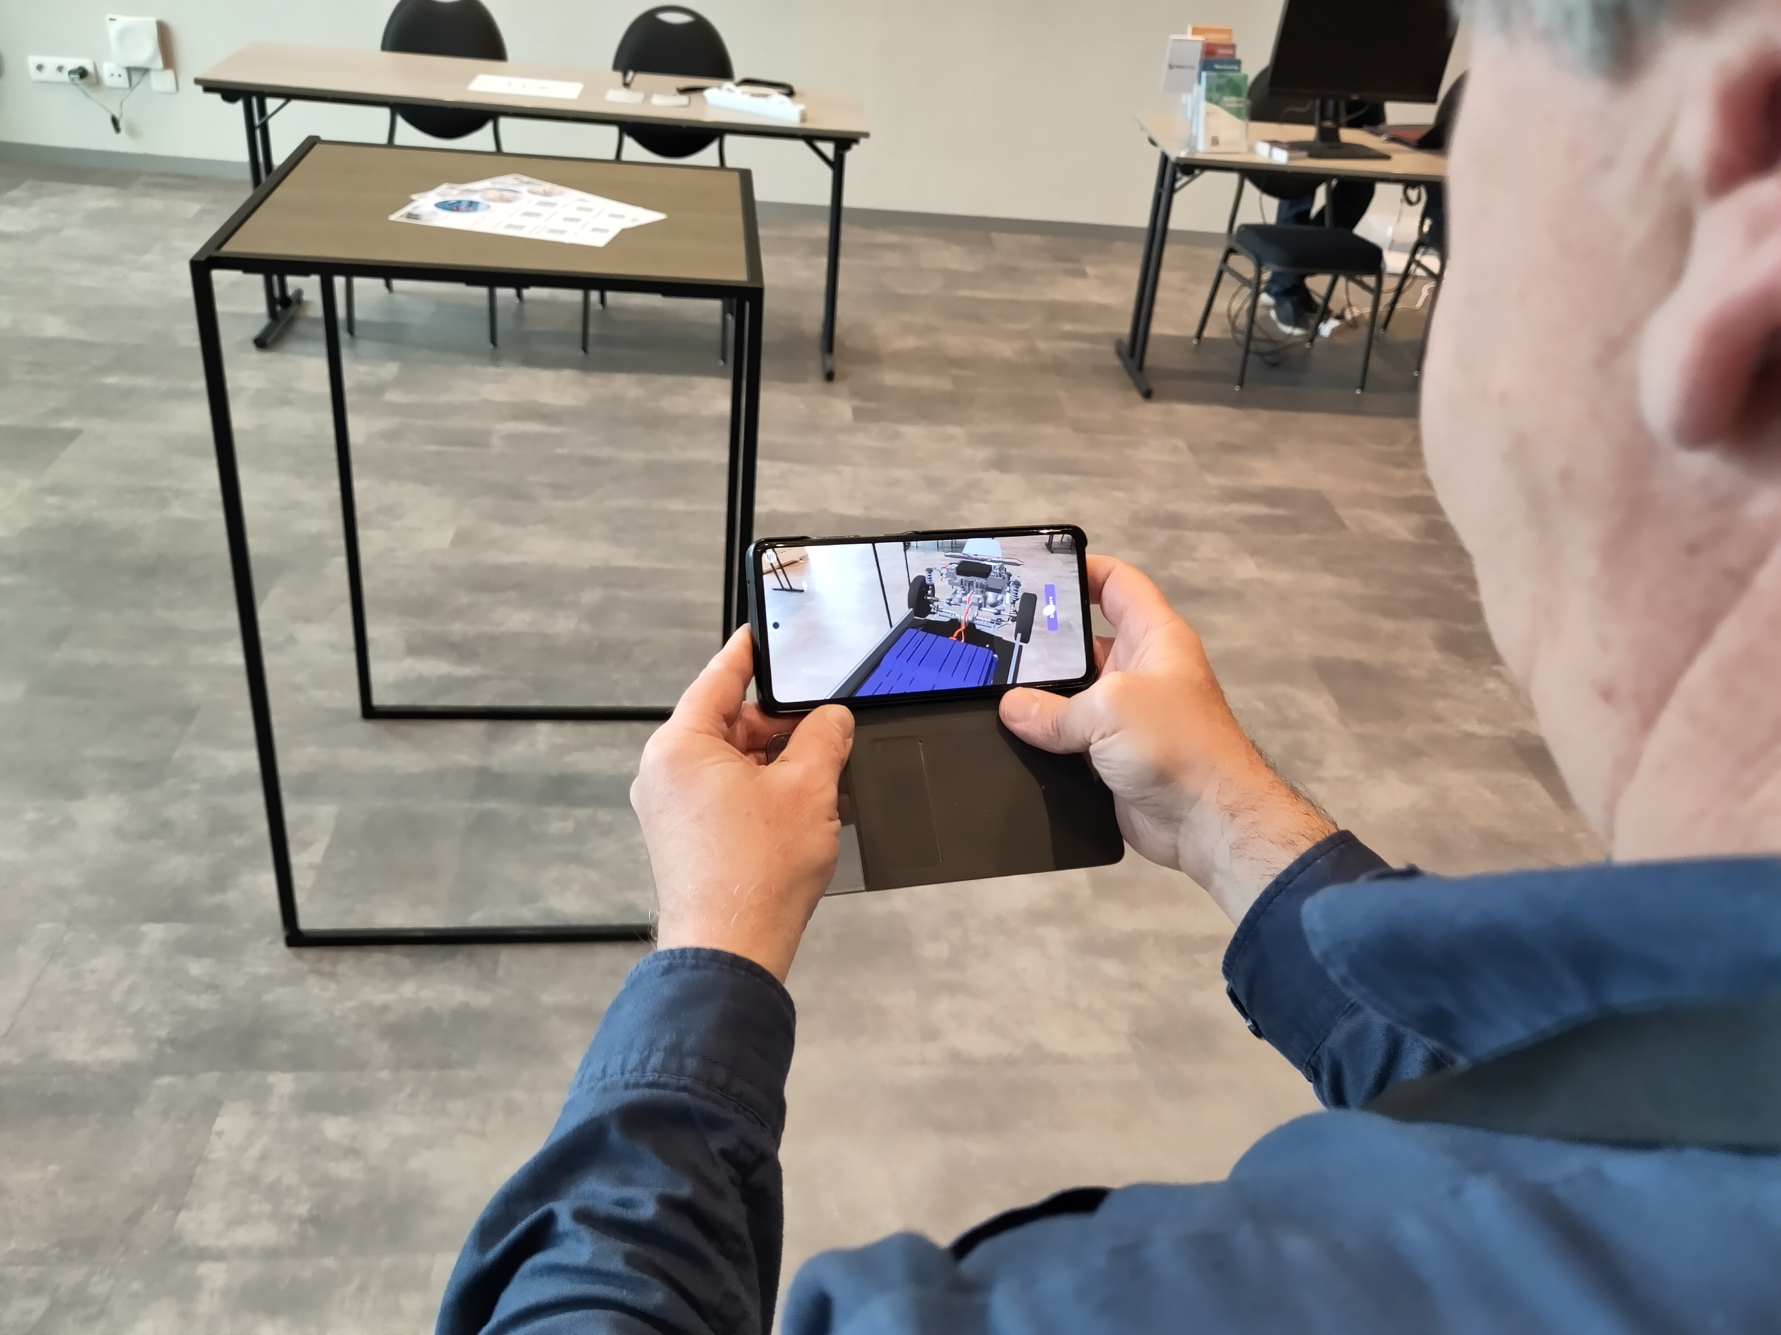
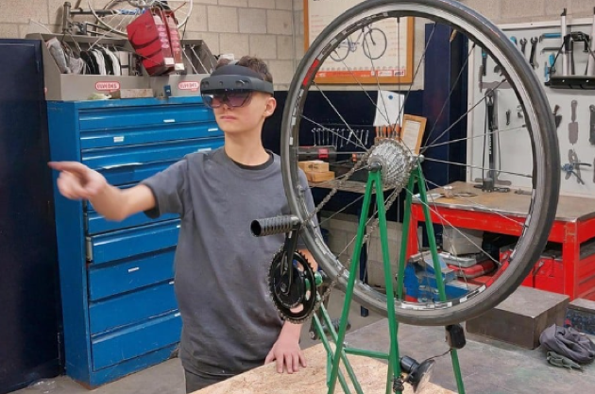
Example : project 2
Training with modern technology in automotive sector
Collabaration GO! – Connectief – Diagnose Car

Slide 14
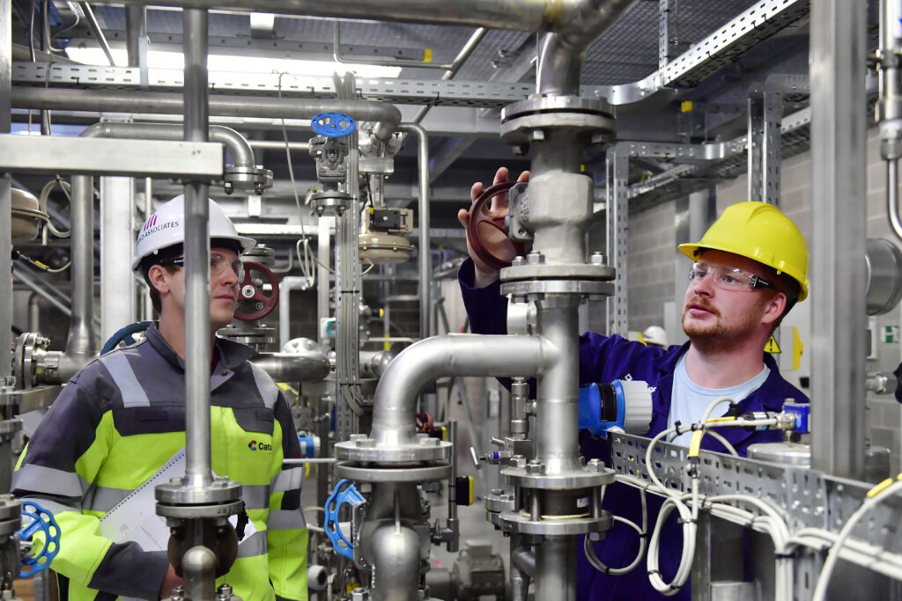
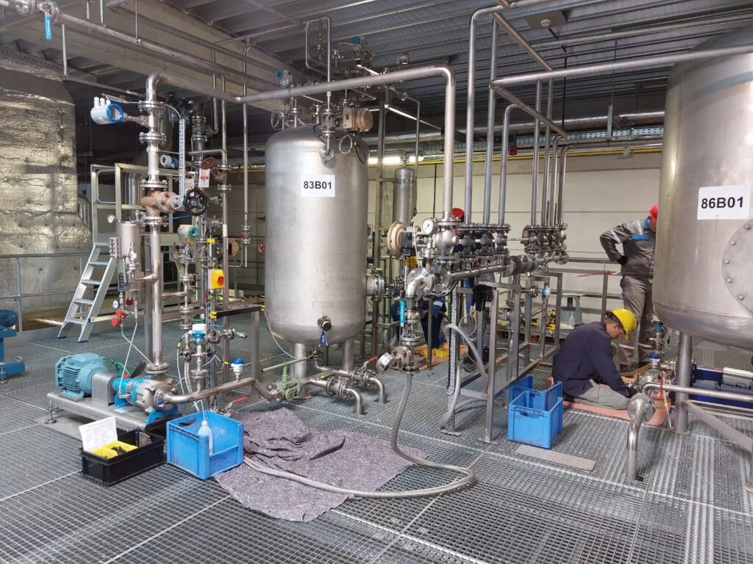
Example 3 : ACTA
collaboration Connectief – Chemical industry training Center
Inleiding
Tekst (niveau 1)
Opsomming (niveau 2)
  Opsomming (niveau 3)
    Opsomming (niveau 4)

Slide 15
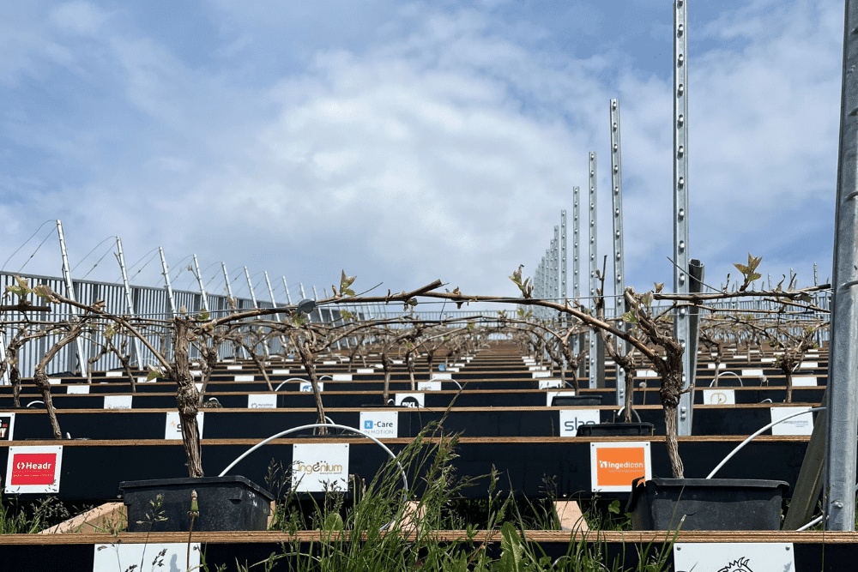
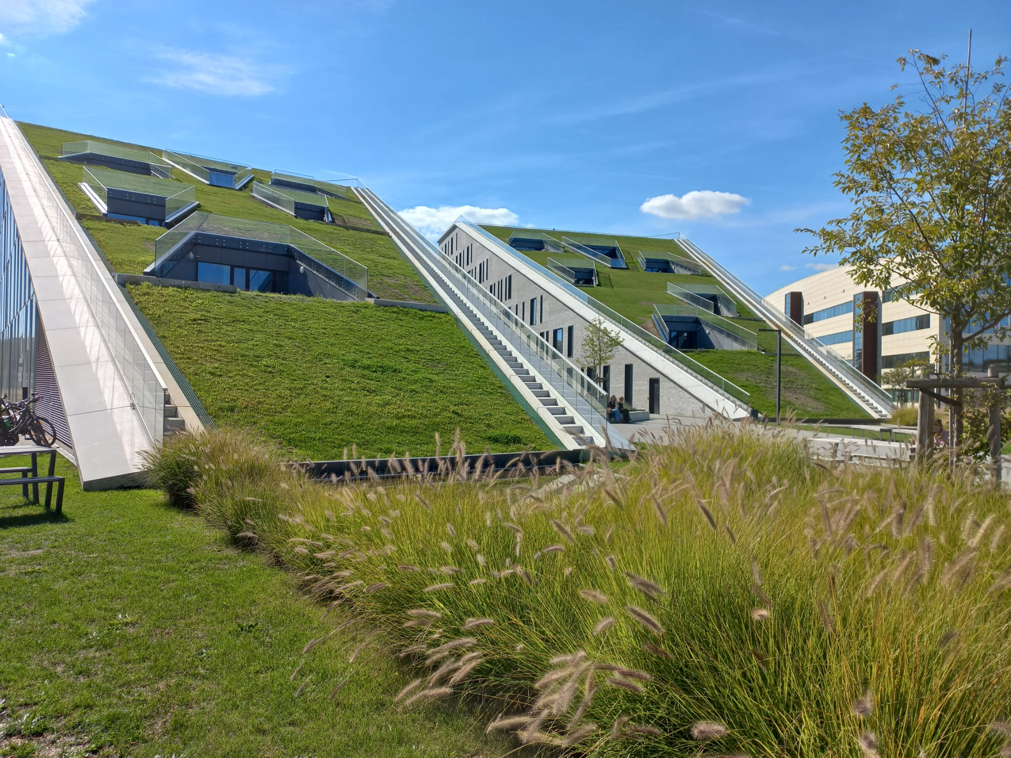
Example 4 : Wine Harvest – Corda Campus
Collabaration innovation Campus – GO! hotel school

Slide 16
Annick Haesaerts
Policy Officer Education, Training and Labor Market annick.haesaerts@g-o.be
+32/492.34.60.20

Slide 17
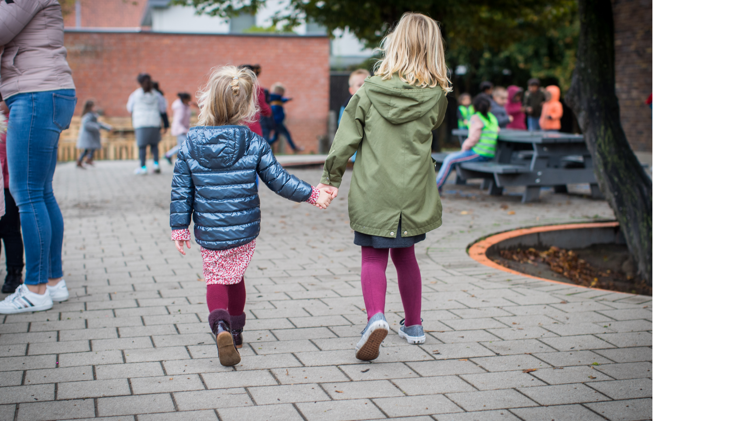
Questions?

