Slide 1
SKYLA
Smart Specialisation Skills Ecosystems for the Twin Transition
Lorenzo Sabatini
Project Coordinator
l.sabatini@asev.it
26th September2023 | S4STRIDE meeting
Notes:
1

Slide 2
SKYLA is implemented in the framework of the Interreg Europe programme and co-financed by the European Union.
“SKYLA’s overall objective is to support public authorities in putting future SKILLS at the centre of the Twin Transitions for a smarter, more resilient development, by boosting and adapting the role of Vocational Education and Training (VET) in innovation ecosystems and smart specialisation strategies.”
€
1,61 M
EU FUNDING
Mar 2023
---------------
May 2027
Notes:
2

Slide 3
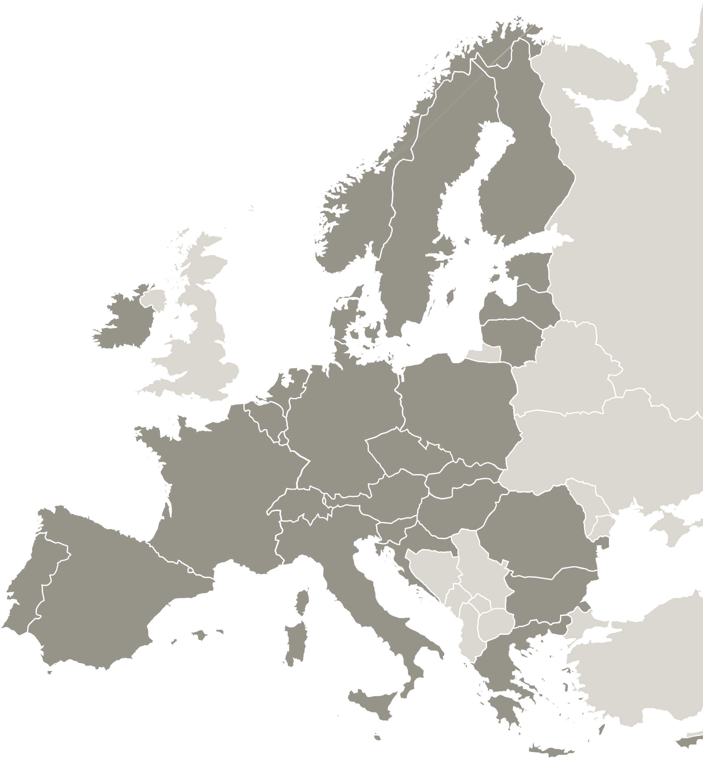
SKYLA partnership
11 Partners and 2 Associated Policy Authorities are partners in the SKYLA project.
11
partners
Partners:
Agency for the development of the Empolese Valdelsa – Lead partner
Podlaskie Voivodeship
Regional Council of Skåne, Department for Regional Development
Industrial Development Center South, Sweden
Sofia Municipality
Cluster of Mechatronics and Automation, Bulgaria
Fingal County Council
Regional Development Fund of Attica
European Association of Regional and Local Authorities for Lifelong Learning (EARLALL)
European Social Fund Agency, Lithuania
Pôle emploi Provence-Alpes-Côte d’Azur
Associated Partners:
Regional Government of Tuscany - Directorate for Education, Training, Research and Employment
Ministry of Education, Science and Sport, Lithuania

Slide 4
An ongoing process of exchange…
In Tuscany, SKYLA represents a new step in the process of exchange with Europe on the new challenges of the programming period that has just begun, such as regional skills ecosystems in support of the twin transition, facilities for higher education, Centres of Vocational Excellence (CoVE)
Training open laboratories 4.0
SECTORS INVOLVED
HIGHER TECHNICAL EDUCATION AND TRAINING
APPRENTICESHIPS AND TRAINEESHIPS
Regional “skill ecosystems”

Slide 5
An ongoing process of growth …
Particularly, starting from a more extensive need to support a stronger integration of the vocational training systems (and policies) in the development and implementation of the S3/S4 strategies and in the regional innovation ecosystems, the Tuscan working group focused on themes and support measures to:
Identification and development of regional skills ecosystems for the forecasting and mapping of the skills of tomorrow in local and territorial production systems
Identification and development of new professional profiles and skills for an evolving working world, with particular emphasis on digital and green transitions.
Upgrading the processes for integrating new professional figures into enterprises by using new modern quality apprenticeship processes (dual) that combine the specific demands of a company with the professional growth of the apprentice.
Development of higher technology education and higher technical training policies through the consolidation of ITS Academies and the strengthening of advanced open territorial training laboratories for advanced technological education and vocational training.

Slide 6
Project methodology overview
Step1 – Policy NEEDS
analysis
Step1 – Policy NEEDS
analysis
Step2 – Policy SOLUTIONS analysis
Step3 – Policy CHANGES from lesson learnt
MEANING
Skills and requirements for SMEs
Knowledge analysis
Needs and challenges
Stakeholders involvement
Analysis of the policy instruments
Good practices identification
Gaps/needs in policy instruments + how lessons learnt can be adapted
Policy Improvement template (ex Action Plan)
Work plan agreement
Policy improvement development and implementation
TOOLS
Methodology document (step 1)
Stakeholder group setup
RSG - Focus on skills and VET/SME needs
Project IW– Workshop and focus group sessions, expert presentations, interregional exchange, study visits
Methodology document (step 2)
RSG - Focus on policy lacks
IW - GP sharing, study visits, external expert involvement, webinar, networking
Bilateral Exchanges (GP’s transfer)
Methodology document (step 3)
RSG- Focus on policy improvement
IW (plenary sessions and exchange for PI template drafting, peer reviews)
Bilateral Visits
OUTPUTS
Knowledge overview for the Twin Transition
Practices and solutions for policy changes
POLICY IMPROVEMENTS
in ALL participant Regions
POLICY IMPROVEMENTS
in ALL participant Regions

Slide 7
Policy need analysis
In a first phase, the regions involved with their stakeholders are invited to carry out a territorial analysis in order to identify the needs and challenges to be addressed in order to respond to the new skills needs in the labour market and how, in this perspective, they can improve the intervention measures. In particular, an investigation of the following sub-topics has been proposed:
Forecasting & developing profiles and skills for the twin transition (future skills)
Capacity building and training the trainer for the twin transition
Relevance given to VET / skills in the Smart Specialisation Strategy
Relevance of VET providers in the Innovation Ecosystem at territorial level
Facilities for modern VET provision to support the twin transition
Other relevant issues (more specific to the local context)

Slide 8
Domande
An initial state of the art on these issues, together with a territorial SWOT analysis, was presented during the first inter-regional exchange tables organized for the project kick-off (Brussels, 15th May 2023), each providing answers to questions such as:
Is the issue a policy priority for the new programming period?
What are the main concerns and challenges? Are there specific experiences and good practices developed?
Are there any initiatives underway or funding schemes to support?
What room for improvement on policy instruments?
On the same issues, starting from the preliminary analysis document, in the period July - October 2023, regional stakeholders (e.g. ITS representatives, VET institutions, players involved in dual apprenticeships, work-based learning ) will also be interviewed through web contact and meetings

Slide 9
Upcoming opportunities and dates
Regional «Policy need analysis»
In parallel in each participating region [May – November 2023]
Interregional event SKYLA-S4STRIDE
Exchange event with the S4STRIDE partnership on skill
ecosystems (final event in Tuscany) [25th-28th September 2023]
SKYLA 2nd Interregional event in EIRE
Next inter-regional event with study visit in the Dublin area
(Fingal county) [7th – 8th November 2023]
Pilot Action opportunity
Opportunity to submit for funding Pilot Actions on the
Interreg Europe programme [Early 2024]
SKYLA 3rd Interregional event in Tuscany
Interregional exchange event and study visit
in Tuscany [April - May 2024]

Slide 10
SKYLA
Smart Specialisation Skills Ecosystems for the Twin Transition
Lorenzo Sabatini
Project Coordinator
l.sabatini@asev.it
26th September2023 | S4STRIDE meeting
Notes:
10

