Slide 1
Erasmus Accreditation
Camilla Winter

Slide 2
Housekeeping Rules
Please make sure that your microphone is off
Please rename yourself stating your “Name Surname - Organisation / Region.” (Right click your image – ‘Rename’)
You can leave your camera open, but please note that pictures might be taken during the session and published on EARLALL’s Twitter account: @earlallEU
You can use the chat box to ask questions to the presenters and interact with other participants.
The session will be recorded and available on earlall.eu/earlall-academy

Slide 3
Why the EARLALL Academy?
The content aims to support our members in their capacity-building at the local and regional level of lifelong learning
Six online sessions in transversal themes and topics pertinent to the whole network
Learning opportunities tailor-made for the needs of EARLALL’s members
Part of EARLALL’s European Year of Skills initiatives
Unique to our members and by invitation only.
Coordinated by the founder of Camilla Winter AB, Camilla Winter

Slide 4
How does the Academy work?
Each session will be a 1 hour MasterClass or ‘lecture’ format
The webinars will be recorded and uploaded onto earlall.eu/earlall-academy
Under each session there will be a PDF of the presentation, lesson notes and unique badge
You can download the badge and share it on social media
If you have any technical questions, please contact charlotte.ede@earlall.eu

Slide 5
Erasmus+ 2021-2027
Key Action 1 - Learning mobility of individuals
Key Action 2 - Cooperation among organisations and institutions
Key Action 3 - Support to policy development and cooperation
Jobshadowing/teaching training assignment/courses/invite experts/invite hosting teachers and educators in training
Short/Long term group mobility of school pupils/adult learners
Short/Long term mobility of VET students
Participation in VET skills competitions

Slide 6
Erasmus+ 2021-2027
Key Action 1 - Learning mobility of individuals – Short term projects for mobility of learners and staff
Key Action 1 - Learning mobility of individuals – Accredited projects for mobility of learners and staff
Accreditation
Activities that contribute to the implementation of the Erasmus Plan
One quality assessment
Regularly funding
Project duration 6-18 months with maximum 30 participants
1-3 Quality assessments by external experts
3 applications during 5 years
For newcomers and for small projects

Slide 7
Erasmus+ 2021-2027
Erasmus accreditation
tool for education and training organisations in adult education, vocational education and training (VET), and school education that want to open up to cross-border exchange and cooperation
individual accreditation for one organisation
accreditation as a mobility consortium coordinator with at least two organisations based in the same Programme Country.

Slide 8
Erasmus+ 2021-2027
Programme countries
EU Member States
North Macedonia
Serbia
Iceland
Liechtenstein
Norway
Türkiye

Slide 9
Erasmus+ 2021-2027
What is a mobility project?
Planning
Preparation
Implementation
Follow-up
Mobility projects in the field of Education and Training for
VET learners and staff
School pupils and staff
Adult education learners and staff
Higher Education students and staff

Slide 11
Erasmus+ 2021-2027
Before you start writing the accreditation proposal
Identify the needs and challenges of your organisation
Describe the outcomes
Define the activities
How can your organisation be improved to benefit its learners?
Anchoring!
Set up a working group
Key persons in charge
OID – Organisation ID
Create an EU Login Account
Deadline 19 October 2023 at 12:00 CET

Slide 12
Erasmus+ 2021-2027
Before you start writing the proposal – important documents

Slide 13
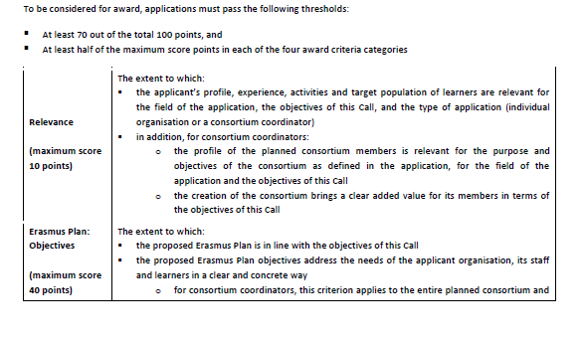
Erasmus+ 2021-2027
Before you start writing the proposal – important documents

Slide 14
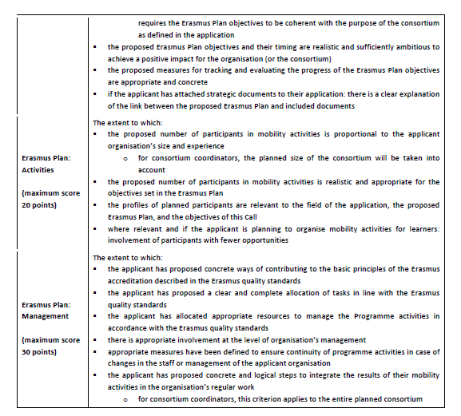
Erasmus+ 2021-2027
Before you start writing the proposal – important documents

Slide 15
Erasmus+ 2021-2027
Each accreditation application covers only one field (school education, adult education, or vocational education and training VET)
One application for Adult education + VET
One application for Adult education
One application for VET

Slide 16
Erasmus+ 2021-2027
Background
What are your organisations main activities (in everyday work, outside of Erasmus+)?
What profiles and ages of learners do you work with?
Structure of your organisation
Management and supervision
Needs and challenges

Slide 17
Erasmus+ 2021-2027
Relevant strategic documents can support your application
International strategy or development plan or …….

Slide 18
Erasmus+ 2021-2027
Erasmus Plan is
a plan that links mobility activities with your organisations needs and objectives
Key question is
how are you going to use the funding to benefit your organisation and all of its staff and learners, whether they take part in mobility activities or not.
Objectives
Management and Resources
Activities

Slide 19
Erasmus+ 2021-2027
Erasmus quality standards – Basic principles
Inclusion and diversity
Environmental sustainability and responsibility
Digital education – including virtual cooperation, virtual mobility and blended mobility
Active participation in the network of Erasmus organisations

Slide 20
Erasmus+ 2021-2027
Erasmus quality standards – Good management of mobility activities
Integrating results of mobility activities in the organisation
Developing capacity
Gathering and using participants feedback

Slide 21
Erasmus+ 2021-2027
Erasmus quality standards – Providing quality and support to the participants
Practical arrangements
Selection of participants
Preparation
Monitoring and mentoring
Linguistic support
Evaluation and recognition of learning outcomes

Slide 22
Erasmus+ 2021-2027
Erasmus quality standards – Sharing results and knowledge about the programme
Sharing results within the organisation and with other organisations and the public
Publicly acknowledging European Union funding

Slide 23
Erasmus+ 2021-2027
Erasmus Basic principles
What will your organisation do to contribute to the basic principles?
Good management of mobility activities
Who will be the Erasmus coordinator? Who will be responsible for montitoring?
Providing quality and support to the participants
How do you plan to divide the tasks for implementation of planned activities?
Sharing results and knowledge about the programme
How to share the results within and outside your organisation

Slide 24
Erasmus+ 2021-2027
Be realistic!
Be concrete!
What? Why? How? When? Who?
Write “We will” instead of “We hope”
Ask a colleague who is not involved in the project to read the proposal and ask for feed back
The evaluators don’t read between the lines and don’t click on links
Don’t expect that the evaluators have specific background
knowledge

Slide 26
What’s Next at the EARLALL Academy?
SAVE the DATE: The New European Bauhaus, 16 March
Coming up in the year: MIL, Sustainability from Erasmus+ Projects…
If any questions were not answered during the session, please contact Camilla Winter at Camilla@camillawinter.se or the EARLALL Secretariat at communication@earlall.eu

Slide 27
Erasmus+ 2021-2027
Thank you for your attention!
Good luck with the proposal!

