Slide 1
Barcelona meeting
23rd November 2022

Slide 2
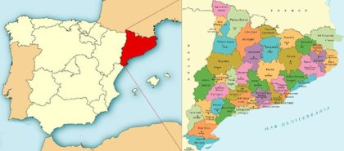
CATALONIA
Languages:
Catalan
Spanish
Aranese
7.767.000 M Habitants

Slide 3
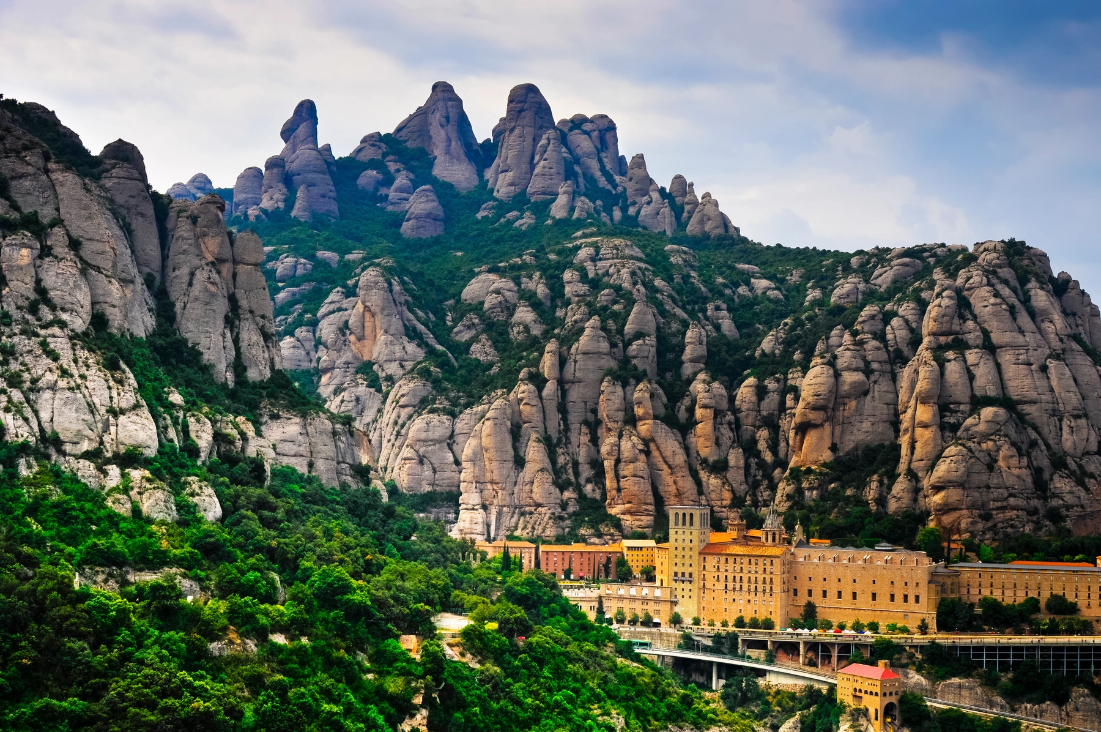
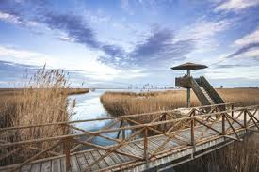
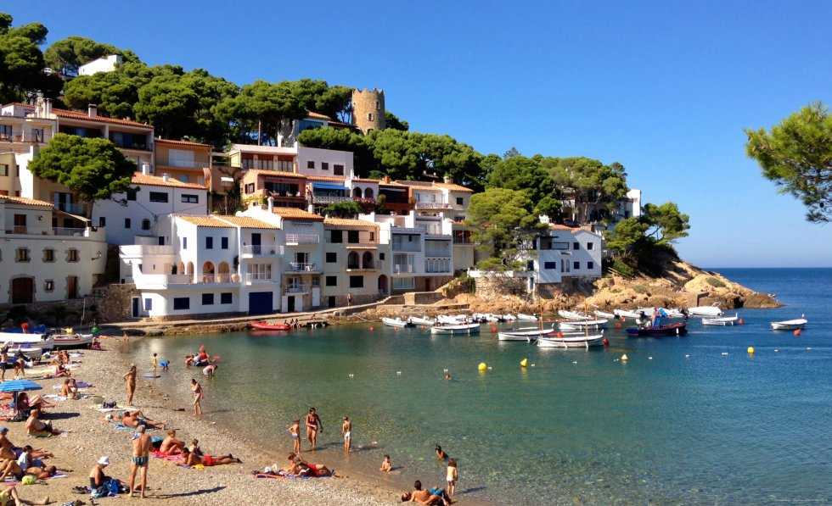
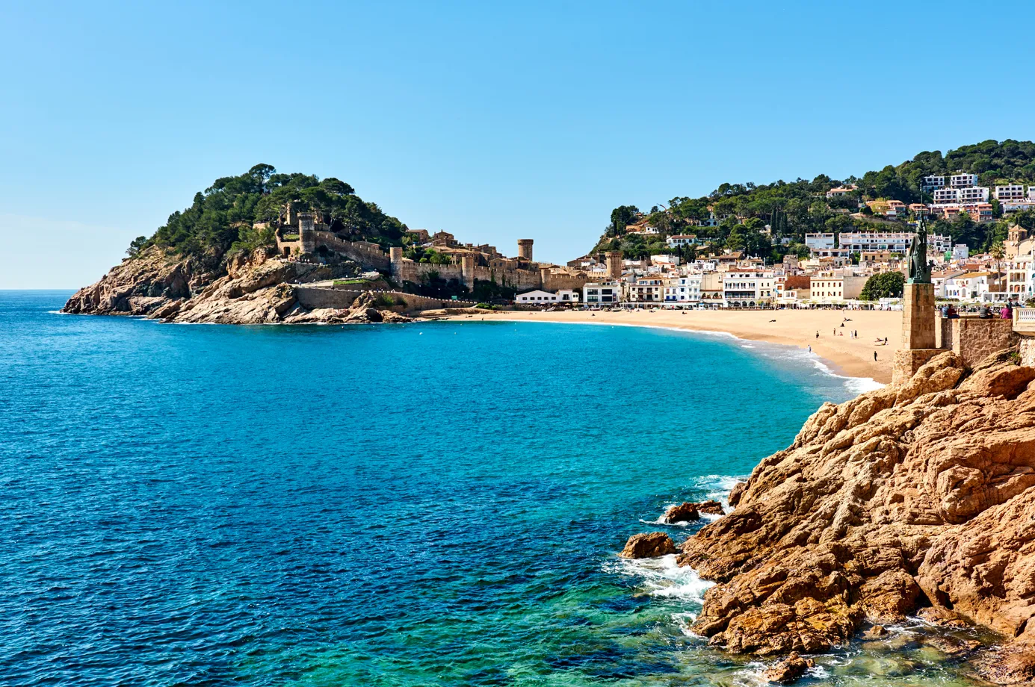
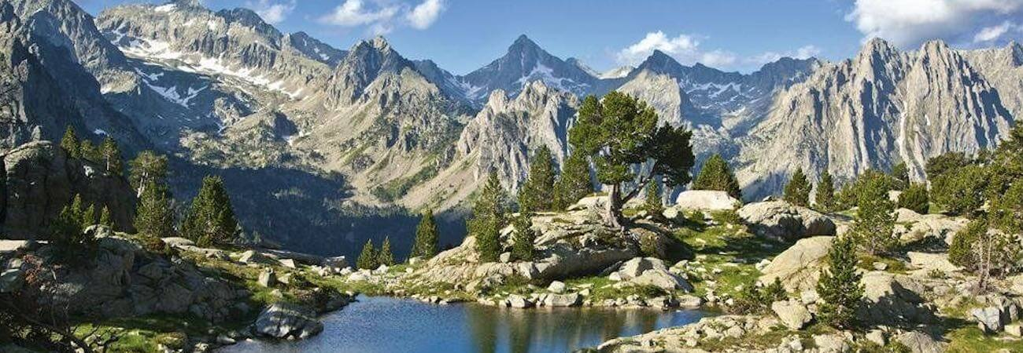
Catalonia Natural Landscapes

Slide 4
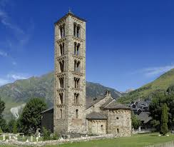
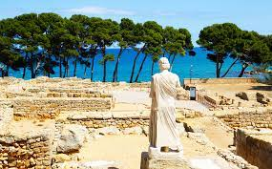
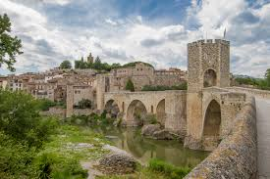
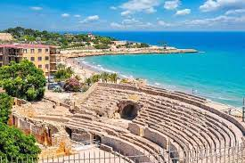
Catalonia history and heritage

Slide 5
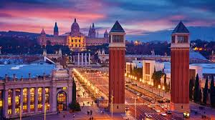
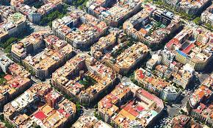
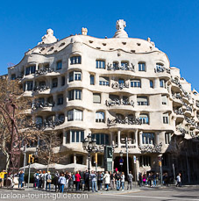
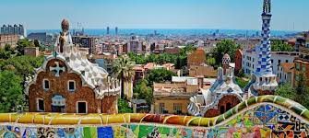
Barcelona City

Slide 6
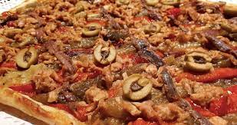
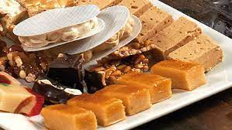
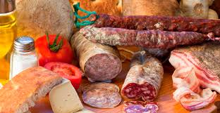
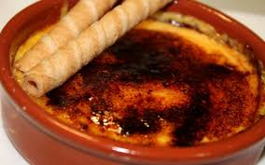
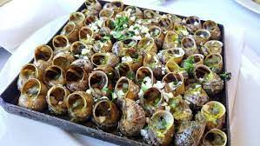
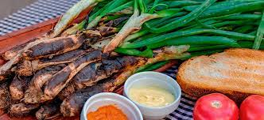
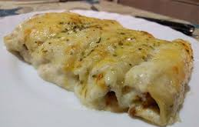
Catalonia. Gastronomy

Slide 7
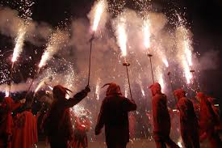
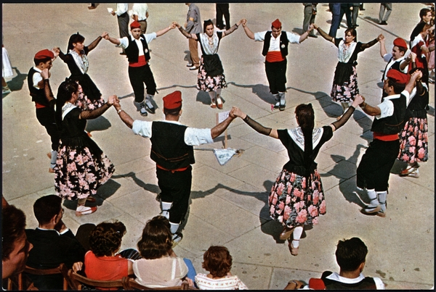
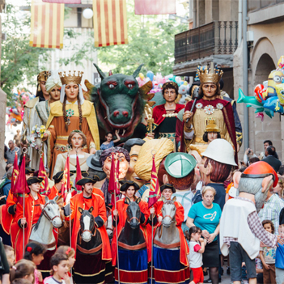
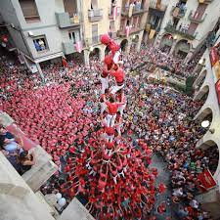
CATALONIA TRADITIONS

Slide 9
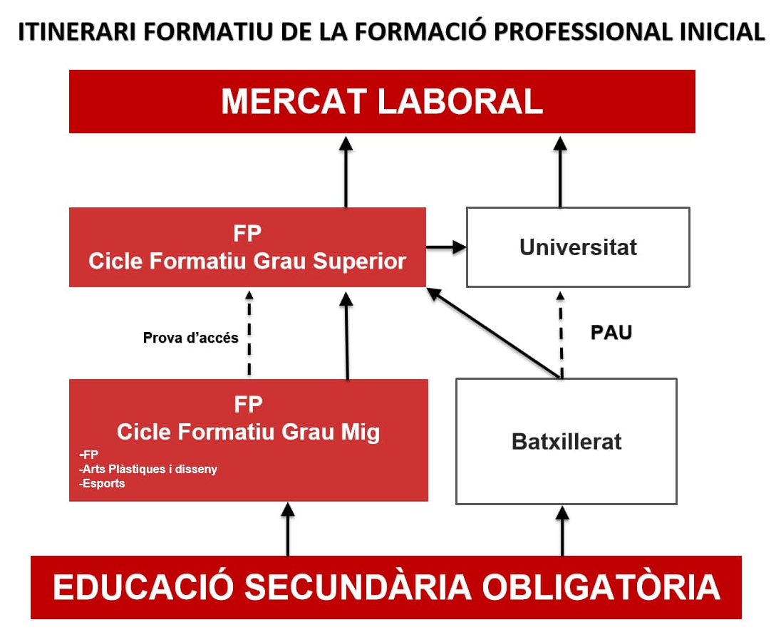
The VET System in Catalonia
EQF 5
EQF 3-4

Slide 10
VET Education in Catalonia
State Competences
Certification of the qualifications
Organization and design of the qualifications
174
VET Certificates
(Intermediate (EQF Level 3-4) and Advanced (EQF Level 5)
376​
VET Training centres
Regional Competences
Design of 45% of the VET qualifications
Organization, revision and establishment of the educational offer.

Slide 11
OBJECTIVES
To foster a close relationship with companies for training, work placements and employment.
To organize, coordinate and monitor the annual educational VET catalog and employment and other VET qualification programs.
To propose curricula for training and employment programs.
To propose and promote teaching methodologies and resources for the continuous improvement of schools and educational excellence to evaluate results.
To promote the participation of companies in the actions of recognition of the work experience and validation of business training.
To promote agreements with companies for the Dual System.
To strengthen the European and international dimension of education.
To organize and coordinate programs and projects related to innovation, quality, entrepreneurship, business services, academic recognition of learning and professional advice.

Slide 12
MISSION
To provide a set of resources, services, programmes, projects and personalized support to VET centres to help them achieve VET Education Excellence.

Slide 13
VISION
To achieve a flexible and modern VET offer in Catalonia, in line with the challenges set out in the Catalan Education Laws and in the corresponding European reference framework, in order to help students acquire the necessary skills and qualifications that allow them achieve personal, professional and social development, throughout life.

Slide 14
UNITS
Notes:
the challenges related to creating local partnerships/engaging local stakeholders in adult learning – either in the context of your region or in the context of the S4Stride project.

Slide 15
EUROPEAN NETWORKS
European Alliance for Apprenticeships
The Working Community of the Pyrenees

Slide 16
THANKS FOR YOUR ATTENTION
More information @:
https://educacio.gencat.cat/ca/inici/
https://sites.google.com/xtec.cat/web-formacio-professional/inici?authuser=0 https://projectes.xtec.cat/mobilitatfp/
twitter.com/educaciocat / twitter.com/FpMobilitat
dgfp.educacio@gencat.cat / mobilitatfp.educacio@gencat.cat

