Slide 1


Slide 2
Three trends in skills development in BW
A large variety of activities, many of them related to digitisation, artificial intelligence and „new“ work
Close links to companies and public employers = skills development related to people in employment and (dual) vocational training and to innovation
In addition, activities in the field of “basic skills” / upskilling in a broad sense = including people with lower qualification backgrounds

Slide 3
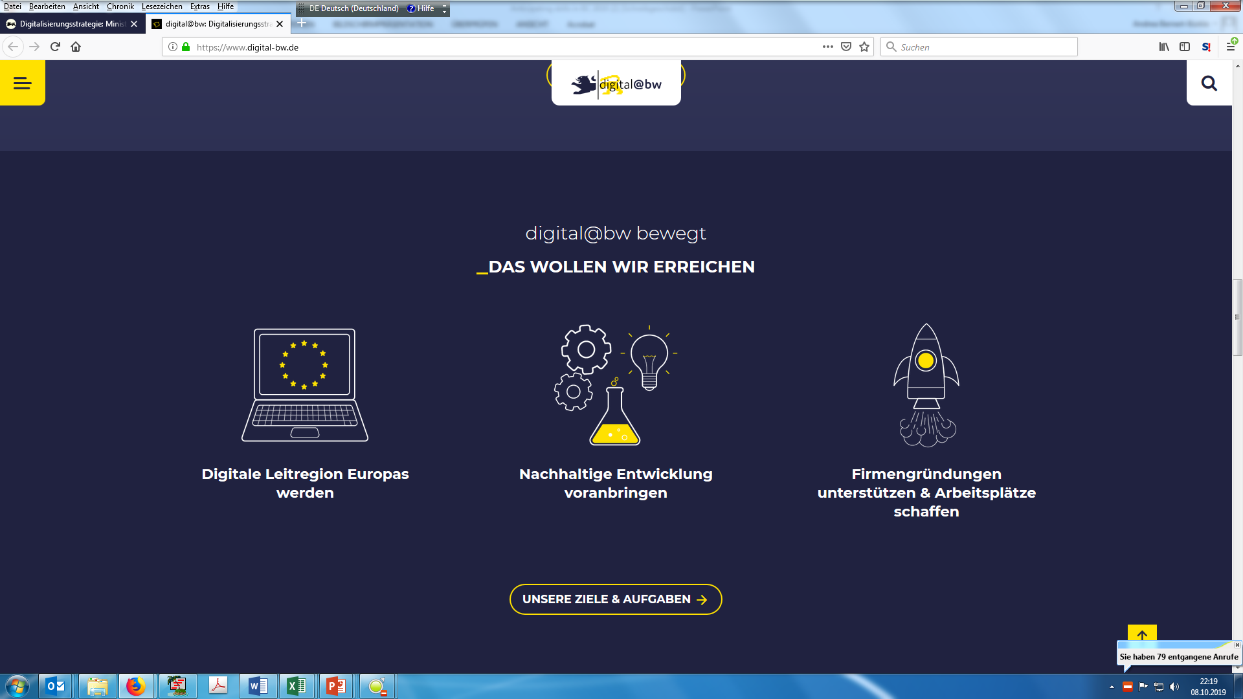
Actions in BW (selection)
Policy actions
Programmes
Wirtschaft digital
Digitalakademie@bw
Digital Hubs
Lernfabriken 4.0
Digitaler Weiterbildungscampus
Basic skills initiatives
Upskillig4all
Digitisation strategy digital@bw
Alliance to strengthen (dual) vocational
training and skilled work
Alliance / pact for lifelong learning

