Slide 1


Slide 2
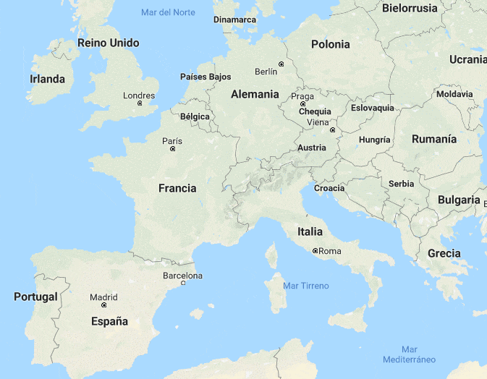
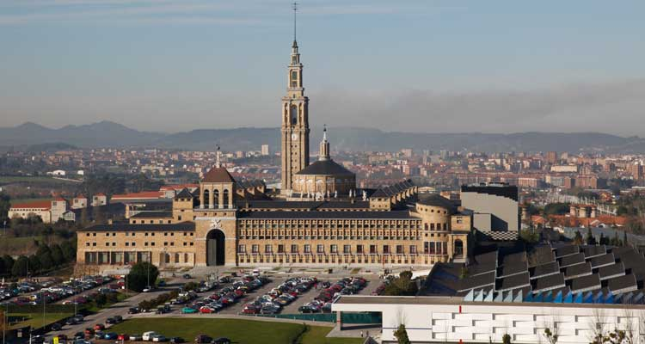
Dual VET in Industrial Chemistry
CIFP SECTORES INDUSTRIAL Y DE SERVICIOS
Former Universidad Laboral
Located at the knowledge mile of Gijón close to technology companies, university schools and other knowledge generating organizations.
Our school offers studies in eight professional families (industrial and service sectors).
108 teachers, over 1200 students.

Slide 3
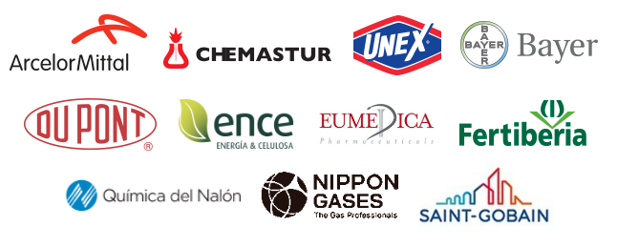
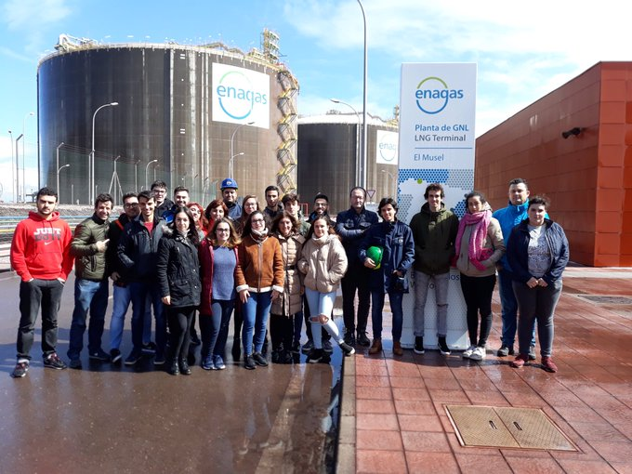
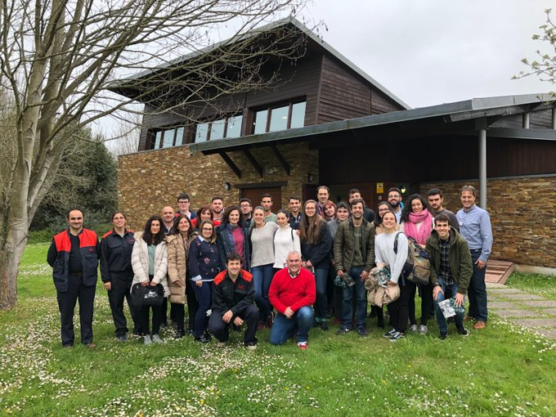
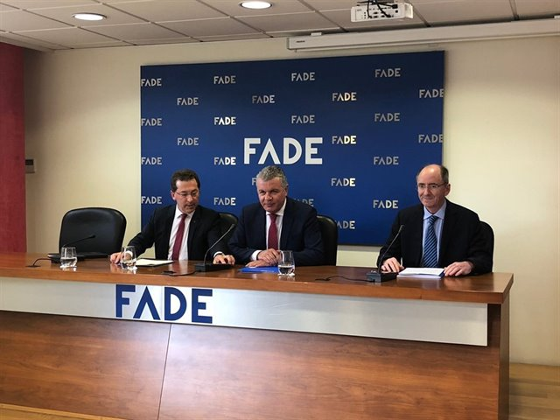
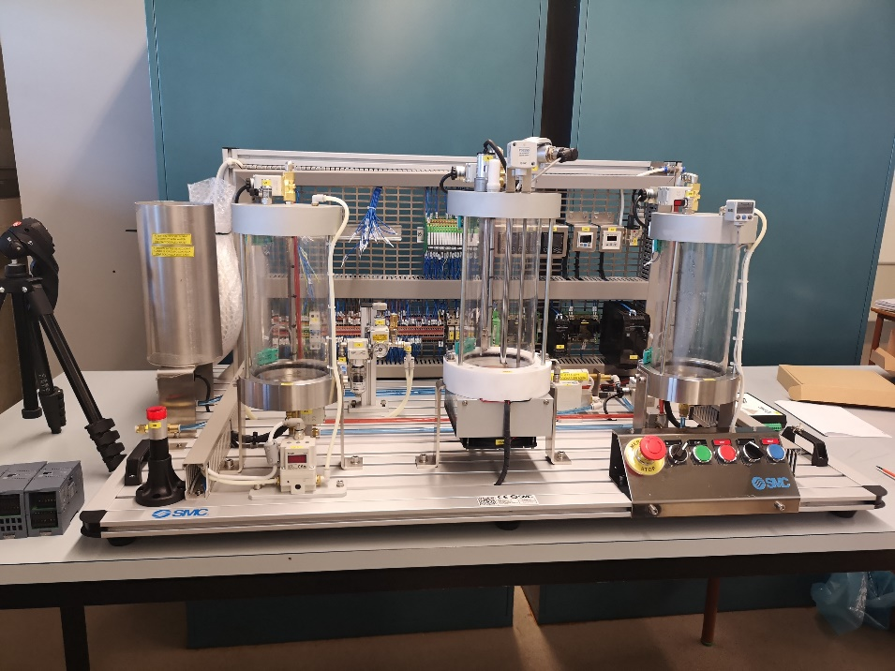
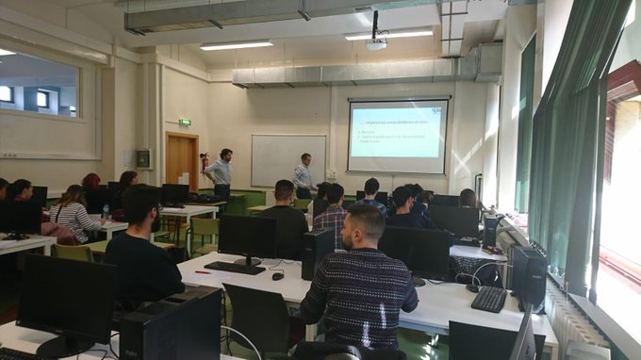
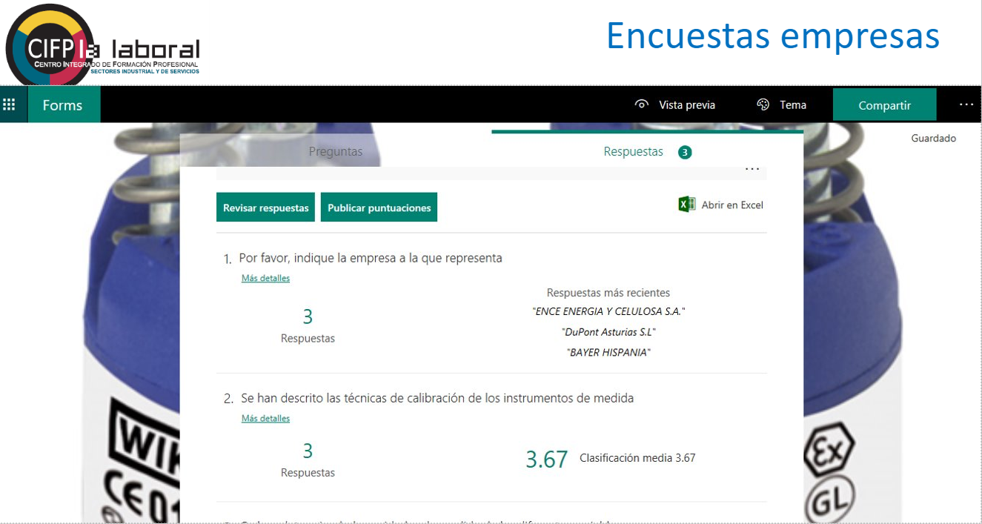
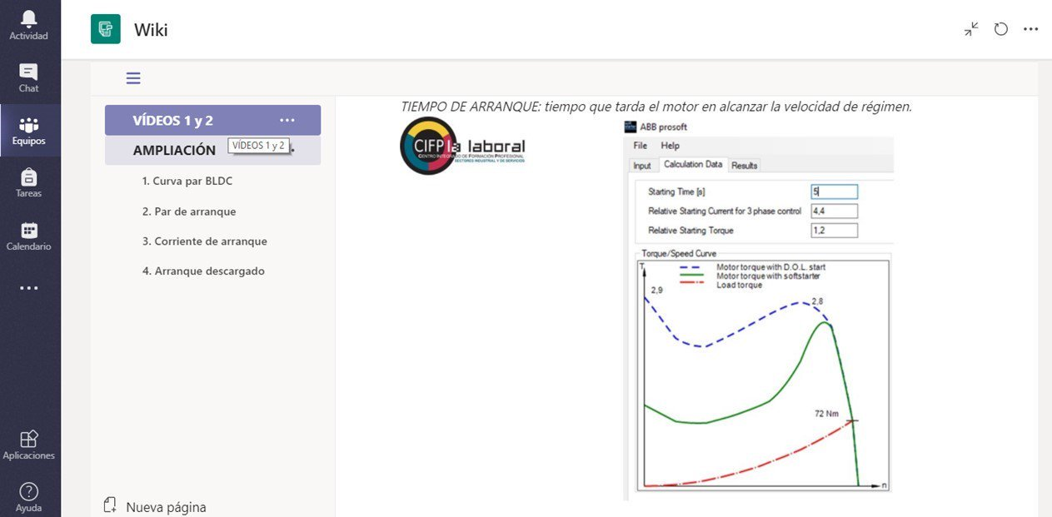
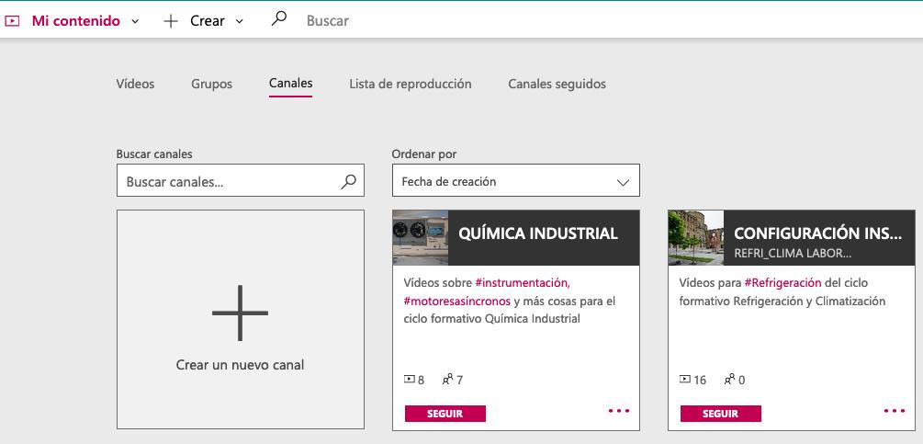
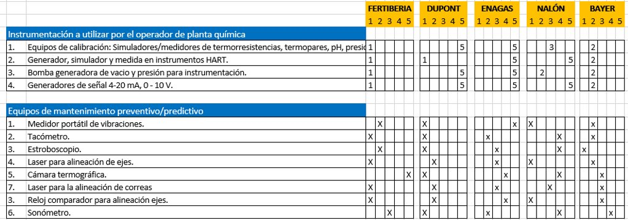
Dual VET in Industrial Chemistry
Main Goal: Improve professional skills of the students.
Challenge: Starting from scratch
Success factors: Great support from chemical cluster companies and regional administration, collaboration between school departments and close communication between companies and the VET center.
Our Dual approach
Agreement between Cluster of chemical companies and regional administration
Use of collaborative tools and active methodologies
Extended internship at companies
Use of web surveys to know the expected skills in students. Analysis of the collected data.
Chemical companies came to our school to give training sessions
Students met Chemical companies
Specific equipment provision

Slide 4
Lessons Learnt
Dual VET must start at schools: practical teachings and adaptation to technological changes
Continuous teacher training
Collaboration is a “must”:
  Between companies and schools
  Between school departments and teachers
Dual VET key:
Students need to acquire professional skills that allow them to continue learning throughout life.

