Slide 1


Slide 2
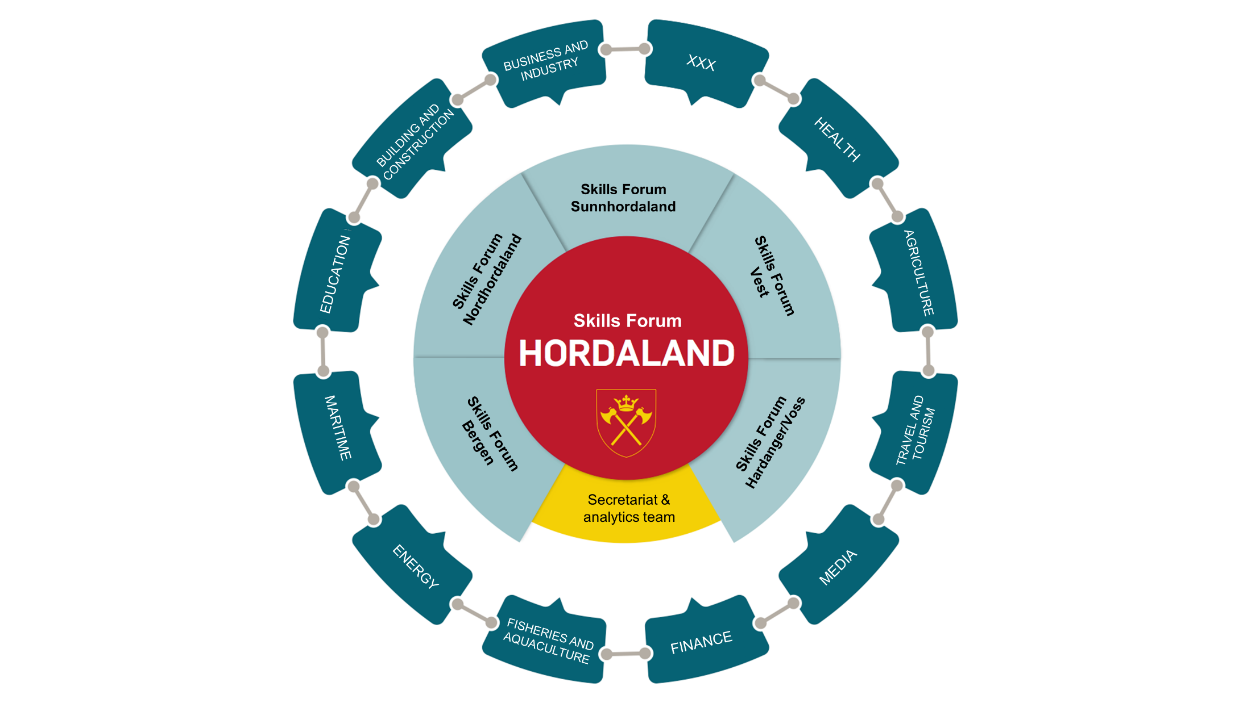

Slide 3
Main Challenges
Statistical knowledge base
Mapping of stakeholders and existing arenas
Information flow
Cooperation across regions and sectors
Identifying skills gap
Sucess Factors
“What’s in it for me?”
Build trust
Decision-making authority
Political support

Slide 4
Lessons Learnt
Involve stakeholders with direct link to the enterprises
If top level – ensure operational capacity
Avoid bottlenecks
Get results

