Slide 1
Future proofing local labour Markets
Jonathan Barr
Head of Unit
OECD Centre for Entrepreneurship, SMEs, Regions, and Cities
10 October 2019

Slide 2

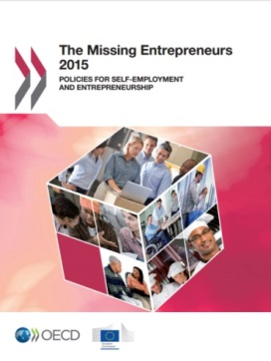








OECD Centre for Entrepreneurship, SMEs, Regions and Cities @ a Glance
Regional Development Policy Committee + 3 WPs
Statistics
(regional, metropolitan, well-being)
Working Party on SMEs and Entrepreneurship
Multi-Stakeholder Engagement
(political and technical)
Tourism Committee + 1 Working Party
Local Economic and Employment Development (LEED) Programme
LEED Forum for Local Development Practitioners, Entrepreneurs & Social Innovators
Champion Mayors for Inclusive Growth
Roundtable of Mayors and Ministers
Thematic work
(culture, global events, entrepreneurship, social innovation)
Trento Centre
(spatial productivity, capacity building)
Thematic work
(megatrends, investment, sustainability, value chains, trade, transport, skills, digitalisation)
SME financing
(Scoreboard, OECD/G20 High Level Principles)
Thematic work
(digitalization, women entrepreneurship, productivity, GVCs, business transfers)
Thematic work
(subnational finance, multi-level governance, land use, green growth, migration)
Country and local reviews
(national, urban, rural, metro, MLG, etc. )
Country reviews
(Local Job Creation, HEInnovate, social ent., social inclusion)
Statistics
(Global Forum on Tourism Statistics, Tourism Satellite Account, trade)
National & local tourism reviews
SME and entrepren. country reviews
Water Governance Initiative
Venice Office
(culture, creative sectors)
SME Strategy
Monitoring tourism trends and policies

Slide 3


Created in 2004, the OECD Local Development Forum (http://www.oecd.org/local-forum) is the OECD’s network of local development practitioners, entrepreneurs and social innovators.
The 2019 OECD Local Development Forum
“Right Skills, Right Jobs, Right Places”
  Plenaries on ensuring employers and workers meet in the middle and building opportunity for all
  Interactive workshops
  Study visits to local initiatives in Antwerp
  Local initiatives marketplace
Participants: 300+ practitioners in local development expected to participate
Key Speakers confirmed: European Commission, Google, Bertelsmann Foundation, Adecco Group, The HOPE Program, UpSocial, Bayes Impact, Centre for Cities

Slide 4
The world of work is changing
Globalisation
Digitalisation
Ageing populations
Notes:
As they deal with persistent unemployment, policymakers must confront at least three medium and long-term structural forces – or mega trends – that are shaping the world of work more than ever:
Demographic change
Globalisation and
Technology, especially the digital revolution.
OECD work has shown that popular perception tends to exaggerate the impact of trade and globalisation on jobs and inequalities.
Evidence suggests that it is technological change that certainly played a major role in increasing labour market polarisation, whereas the impact of deepening GVCs is difficult to detect and probably not so high.
Digitalisation offer many new and exciting opportunities :
New technologies open new markets and create more productive jobs.
Digitalisation is already providing people with increased autonomy in how they work, when they work, and even where they work.
But digitalisation also poses important challenges :
There are a significant proportion of jobs that will be restructured or may disappear altogether.
As digital technologies enable the production of more goods and services with less labour, they also expose some workers to the risk of unemployment or lower wages.
They also enable changes in the organisation of work, with implications for the capability of existing policies and programmes to ensure labour market inclusion, job quality and skills development
Governments, businesses, and social partners need to address these new economic and labour market challenges.
They should also improve their ability to detect emerging labour market trends; and
They should explore ways of developing existing labour market programmes and safety nets so as to ensure inclusive growth and job quality in the new work organisation enabled by the digital economy.

Slide 5
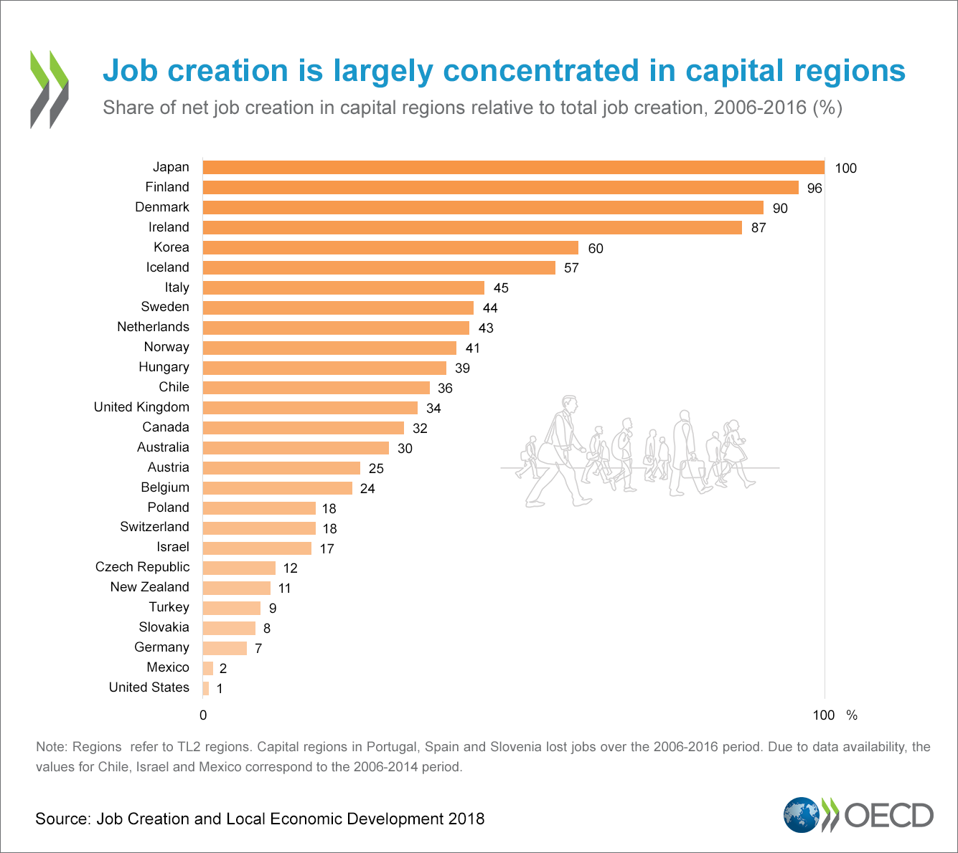
Job creation is not occurring everywhere; capital regions tend to be particularly successful
15 out of 27 OECD countries had 30% or more of national job growth in the capital region over the last decade
Notes:
When we go sub-national, we observe that some regions have been better at creating jobs than others.
For instance, the growth of the employment rate varies almost 4 percentage points across regions within the same country.
Capital regions, typically highly urbanised, tend to be more successful – attracting firms and workers more than elsewhere.
The chart on the screen shows that 15 out of 27 OECD countries had more than 30% of net employment generated in their capital region

Slide 6
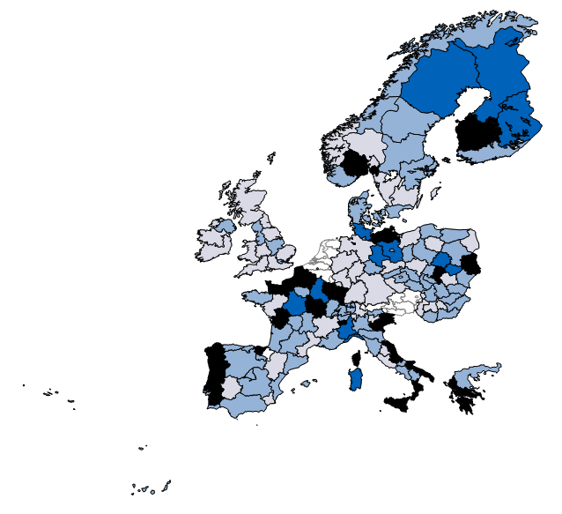
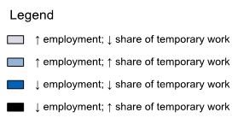
In over 60% of regions with employment growth, growth was due to an increase in temporary jobs
Changes in net employment and the share of the workforce in temporary work, 2012-16
Source: OECD calculations based on EU Labour Force Survey
Notes:
The map on the screen shows that in Europe, more than 60% of the regions that increased employment over the period 2012-2016 which corresponds to the recovery period - did so by rising temporary jobs
But some regions had created more temporary jobs or part time jobs than others - within countries, there can be very wide variations, up to 20 percentage points.
When looking at the likelihood of being in a temporary contract, this is higher for certain types of people and places:
In terms of people, it is more likely for the youth, the low-skilled, and women
In terms of regions, it is more likely for those regions with a less educated workforce, smaller tradable sector, and more rural.

Slide 7
Regional variations in non-standard work are notable
Share of temporary and part-time workers in TL2 regions’ employment, 2016
Source: OECD calculations based on EU Labour Force Survey
Notes:
Considering those in either - temporary or part time work - we see again that within countries, there can be very wide variations, up to 20 percentage points.
In more than 60% of the regions that increased employment, they did so by rising temporary jobs
When looking at the likelihood of being in a temporary contract, this is higher for certain types of people and places:
In terms of people, it is more likely for the youth, the low-skilled, and women
In terms of regions, it is more likely for those regions with a less educated workforce, smaller tradable sector, and more rural.

Slide 8
The rise of non-standard contracts is another element of the future of work
Temporary, part-time, and self-employment
Benefits | Risks
Flexibility in the labour that improves productivity through better allocation of workers to jobs | Lower social protection or health benefits
People previously unemployed able to obtain a job – greater inclusion | Less investment in skills upgrading
Lifestyle choice for well-being of worker (work less or on own terms) | Non-standard forms of employment as a last resort, not by choice
Notes:
The future of work is not only about automation, digitalisation and the changing skills needs,
it is also about the contractual forms of employment – what we call non-standard employment - temporary job contracts, part-time work, or self-employed.
Non-standard work generate opportunities for workers, in terms of flexibility and variety of work.
But there are many risks. Worker may lose out on access to unemployment, pension or health benefits.
They may also be faced with no choice in their local labour market and take these forms of employment as a last resort.

Slide 9
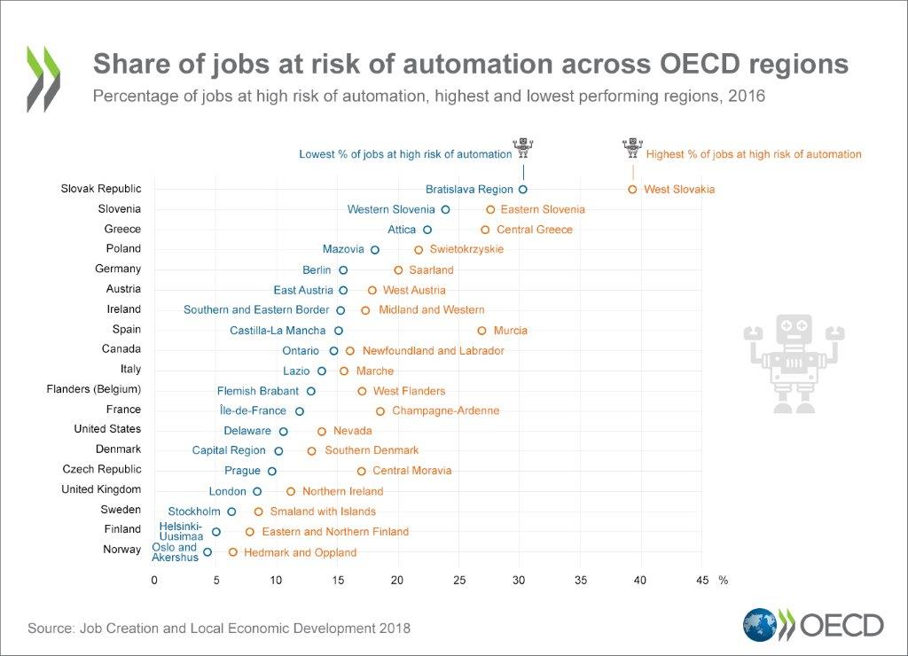
Where are jobs likely to change?
The risk of automation varies within countries
Notes:
The OECD has estimated that 14% of jobs are at high risk of automation – high risks of automation means that more than 70% of their tasks are likely to be automated.
We also estimated that another 32% are likely to experience significant change.
But in which regions, jobs are likely to change the most?
With this report, for the first time, we have evidence of the risk of automation at sub-national level [we look at OECD regions]
We found that:
Across the 21 OECD countries for which data is available, the share of jobs at risk of automation varies more than nine-fold:
from 4% in the region of Oslo and to almost 40% in the region of West Slovakia.
When looking across regions within a country, the difference can be as large as 10 percentage points – which is the case for Spain, the Slovak Republic and the Czech Republic.
Other countries such as France, Germany and Greece also show large differences.
In general, we observed that those regions with a lower share of jobs at risk of automation are those that:
are more urbanised
have a greater share of educated workers,
Haver a larger service sector (including tradable services),
Conversely, regions that already have low productivity growth and high unemployment are more likely to be further affected by automation, thus exacerbating their underperformance trap.
This means that existing divides across places – which has generated the so-called geography of discontent - are likely to grow over time if nothing is done.

Slide 10
The good news is that 60% of regions recently created jobs and did so in low risk occupations
Number of TL2 regions by categorisation based on net employment changes and the automation profile of jobs , 2011-2016
Source: OECD calculations based Labour Force Surveys
Notes:
But again, we should not be pessimistic
To understand some of the dynamics across different regions, we grouped regions into four categories depending on:
Whether they created or lost jobs overall, and
whether those jobs – created or lost - were in occupations at higher or lower risk of automation.
The good news is that - over the period 2011-2016 — 60% of regions created jobs in low risk occupations (large blue bar).
These regions are making the transition.
But many other regions are losing jobs—almost a third that you see here in orange--and this is more worrying when this is happening in those occupations at lower risk of automation (dark orange).
This means those regions are loosing good quality jobs
So what can policy do? The answer is: it depends on the types of regions and the dynamics operating in them

Slide 11
Technological progress and digitalisation are contributing to job polarisation, 2000-17
Source: OECD Calculations based on EU Labour Force Survey
Notes:
High Middle Low
Småland with Islands 21 64.9664 -29.215 18.39899
South Sweden 22 147.2915 -22.8547 37.3463
East Middle Sweden 12 109.9468 -33.8949 32.2491
North Middle Sweden 31 39.1125 -23.9196 12.91454
West Sweden 23 142.2118 -15.0718 68.1851
Sweden 1 772.2221 -147.243 262.5008
Central Norrland 32 23.28107 -7.14689 0.90649
Stockholm 11 214.1299 -10.3442 84.8853
Upper Norrland 33 31.28212 -4.79575 7.61496

Slide 12
There are widening gaps between regions in the quality of jobs and skills
Geographical gaps in post-secondary education levels, sub-regions, 2000 and 2014 elected OECD countries, 1995 to 2015
Percentage point difference between leading and trailing sub-regions
Notes:
Widening gaps in productivity, jobs and skills
Entrenched low-skills equilibriums
Places growing unequal
…. Fuelling the geography of discontent

Slide 13
Why look at VET locally?
….because there is regional variation within countries
Share of students in upper secondary education following vocational programmes, 2016
Italy
United Kingdom
Spain
Source: Eurostat regional database
Notes:
When we go sub-national, we observe that some regions have been better at creating jobs than others.
For instance, the growth of the employment rate varies almost 4 percentage points across regions within the same country.
Capital regions, typically highly urbanised, tend to be more successful – attracting firms and workers more than elsewhere.
The chart on the screen shows that 15 out of 27 OECD countries had more than 30% of net employment generated in their capital region

Slide 14
Key issues when establishing regional skills ecosystems
High quality skills development programmes are an important ingredient to promoting local economic growth
As there is considerable diversity in jobs available and skills in demand at the local level, empowering local stakeholders to tailor training to local needs is an important complement to better alignment at the national level
Even when the right governance arrangements are in place, weak implementation capacities can undermine the alignment between skills being produced and the local labour market
Training and capacity-building for teachers, trainers and institutions as well as promoting sharing between stakeholders can help to strengthen capacities

Slide 15
Apprenticeships can be powerful tool to create pipeline of talent within local labour markets
Key Findings
Local leadership can facilitate connections between employers, training providers, and other stakeholders
Building “spaces” or networks for employers to provide advice is central
SMEs will often require specialised assistance to provide apprenticeship places
Apprenticeships must be flexible in their design and delivery to accommodate changing labour markets
Notes:
Local leaders can be “champions” forging connections between employers, young people and training providers to encourage participation and completion in apprenticeship programmes. Mayors, regional development organisations, and other local level government representatives are important actors in reaching out to employers to promote awareness on the benefits of investments in apprenticeship and assist employers (especially SMEs) in navigating the administrative processes to participate as well as the government supports available.
Building “spaces” or networks for employers to provide advice is central. Collaboration is often formalised in countries with a long tradition of apprenticeship training. For example, as noted in the case study from Germany, representatives from groups of employers, including the German Chambers of Industry and Commerce, actively collaborate with trade unions and government actors in the process of developing national training regulations that enable apprentices to move between federal states. However, collaboration can also arise organically through local efforts to promote skills development. For example, the case studies from New Zealand and the United States highlight the role of local leaders, including those from civil society, in building organic and community-driven skills development mechanisms.
By virtue of their size, SMEs will require more assistance to provide apprenticeship placements. Specialised incentive mechanisms, including tax exemptions, subsidies, the provision of networks or custom placement assistance, can help to improve SME participation in apprenticeship programmes.
Flexibility can be incorporated into vocational education and training systems in a variety of ways. For example, incorporating modular components into programmes can take into account past work experience and can enable movement between conventional academic and vocational pathways for young people. This can address perceptions of “lock-in” and path dependency, where young people choose not to pursue vocational pathways because of a lack of transferability to other learning pathways. Providing options for apprentices, such as intensive courses or part-time arrangements, can provide flexibility for young people and can also better fulfil the demand for employers with more variable or seasonal demand.

Slide 16

But barriers remain to have more employers participate in apprenticeship programmes
Results from an OECD employer survey :
Why did your organisation not offer apprenticeships over the past year?
Northern Ireland
Australia
39
Source: OECD (2019), Engaging Employers and Developing Skills at the Local Level in Northern Ireland, United Kingdom and OECD (2019 forthcoming), Engaging Employers and Developing Skills at the Local Level in Australia
Notes:
Furthermore, there are concerns that financing for adult learning is not reaching the groups who could benefit most (low-skilled people, older workers, immigrants,…). For example, low-educated and older adults are under-represented in applying for career guidance and training vouchers, and as this graph shows, low-educated adults are also less likely to benefit from employer-provided training.

Slide 17
Possible checklist for local communities
Understand the local labour market
✓
Promote lifelong learning and retraining
✓
Develop employment programmes to transition workers
✓
Leverage social innovation to help under-represented groups
✓
Create new jobs through entrepreneurship and SME support
✓
Build stronger local partnerships
✓
Notes:
Local leaders are at the forefront of ensuring that communities benefit from the new opportunities that are likely to emerge from automation and digitalisation. The following checklist can help you think more critically about new local strategies to prepare your community for the future.
Understanding the local labour market: Gathering evidence about skills and jobs can help stakeholders understand who is hiring and what job opportunities exist in your region
Promote programmes for lifelong learning: Skills are a key route out of poverty. Look for opportunities to increase participation in apprenticeship programmes, which combine both on and off the job training working directly with employers
Develop employment and adjustment programmes to help those workers who have been displaced by changing skills needs into a new job quickly. This includes robust career counselling and coaching to help people define their new career aspirations.
Leverage social innovation: Social economy organisations can produce new jobs while also producing goods and services that create positive social, economic, and/or environmental impacts.
Create new jobs through entrepreneurship and SME development: SMEs are a key source of jobs within any community and require customised support to nurture their growth potential. Clustering small firms together can help to define their needs and better link them to workforce training opportunities.
Build stronger local partnerships: More can be accomplished when a broad range of partners work together towards a common goal. Workforce development agencies, community colleges, employers, and others all have a role to play in building better economic and social outcomes.

Slide 18





What are OECD regions doing to promote skills?
United Kingdom
Skills Advisory Panels: These enable mayors and Local Enterprise Partnerships to support employers, education providers and local government in identifying current and future local skills needs shaping the provision and funding of post-16 education and training and careers guidance
Australia
Through the Skilling Australians Fund (the SAF), Australia is committed to working with industry to ensure the vocational education and training (VET) sector responds effectively and efficiently to the skills required by employers and supporting apprentices and trainees. With matched funding from states and territories, the SAF will grow the number of apprentices and trainees to support Australia’s future productivity, jobs and growth.
Ireland
Ireland has 16 Regional Education and Training Boards that manage and operate second-level schools, further education colleges, multi-faith community national schools and a range of adult and further education centres delivering education and training programmes.
United States
Workforce Investment Boards (WIBs) are established for every state and local area in the US. A WIB’s role is to provide leadership and oversight for workforce investment activities that increase employment, retention and earnings. A core mission for WIBs is to form partnerships among public workforce agencies and business so that the workforce system is responsive to the needs of business and the community
Sweden
Regional Competence Platforms have been established to improve coordination between local government and regions regarding skills planning, labour market information, and training programmes. These platforms are part of Sweden’s National Strategy for Sustainable Regional Growth and Attractiveness
Notes:
In the UK, Local industrial strategies are established as part of the national Industrial Strategy. They will identify local strengths and challenges, future opportunities and the action needed to boost productivity, earning power and competitiveness. Mayors will lead on local industrial strategies in combined authorities and will be supported by Local Enterprise Partnerships. As part of implementation of this strategy, the government will work with Mayoral Combined Authorities and Local Enterprise Partnerships across all areas of England to establish Skills Advisory Panels. These will enable mayors and Local Enterprise Partnerships to support employers, education providers and local government in identifying current and future local skills needs shaping the provision and funding of post-16 education and training and careers guidance.
In Australia, A renewed focus on apprenticeships and traineeships will boost the number of people who choose and succeed in this pathway and help address skills shortages across Australia. An estimated $1.5 billion will be available from the Government for the SAF between 2017–18 to 2021–22. With matched funding from states and territories, the SAF will grow the number of apprentices and trainees to support Australia’s future productivity, jobs and growth. Six states have signed the Agreement: New South Wales, South Australia, Western Australia, Tasmania, Australian Capital Territory and Northern Territory.
In Ireland, There are 16 Education and Training Boards, which are statutory authorities which have responsibility for education and training, youth work and a range of other statutory functions. ETBs manage and operate second-level schools, further education colleges, multi-faith community national schools and a range of adult and further education centres delivering education and training programmes.
In the United States, Workforce Investment Boards (WIBs) are established for every state and local area in the US and its territories. The main objective is to create strong local partnerships between business and the community that create systemic responses to each community’s economic development and workforce needs. The goal of the partnerships is to enhance the skill sets and earning potential of citizens, including those who are unemployed or who have special needs and provide employers with skilled workers.

Slide 19

For more information
To discuss OECD’s work on local employment and skills projects:
Jonathan.barr@oecd.org
To learn more about the OECD’s Centre for Entrepreneurship, SMEs, Regions and Cities: http://www.oecd.org/cfe/
Twitter: @oecd_local, #OECDlocal
42

