Slide 1

Transversal Competences in Situation of Mobility
A Storyboard

Slide 2
The pitch
Three youngsters: one from France (Kevin), one from Czech Republic (Anna), one from Germany(Martin), all following VET studies in their own countries
Kevin is studying servicing in France
Anna is studying Hospitality Management in C.R.
Martin is studying commerce in Germany
All three are involved together in an internship in the same hotel in Stuttgart: Kevin for the maintenance of technical devices, Anna in the hotel reception and Martin as hotel concierge

Slide 3

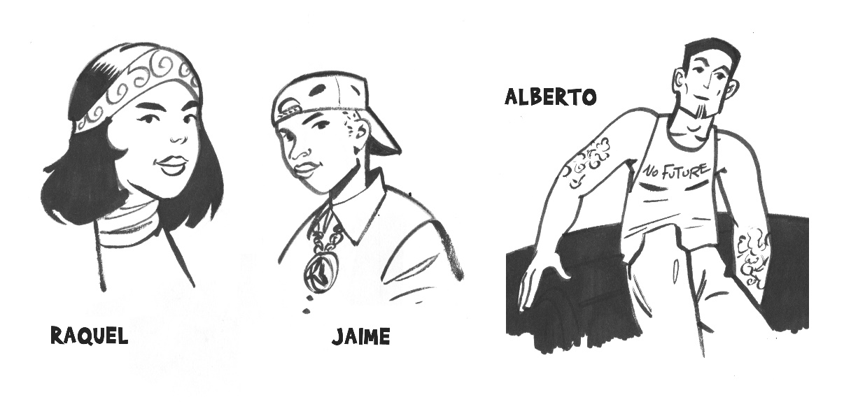
The actors
The context
Kevin is trained in a technical learning programme
He has taken a few hours of German language, as well as looked at a few videos about Stuttgart. He likes sports and going out with friends, but is not too much interested in studies. The internship in Germany is an attempt of his school to help him get back to studies concerns. He lives in Montpellier.
Anna is rather fluent in German. She is aware of the implication of client relationship, though she never experienced them by herself.
Martin is a bit younger than the other two. It is his first experience in a hotel. He is at the very beginning of his studies and wants to check if it is the "right job" for him. He likes basketball, owns a Vespa and uses to live in a small town in the countryside.
Kevin
Anna
Martin

Slide 4
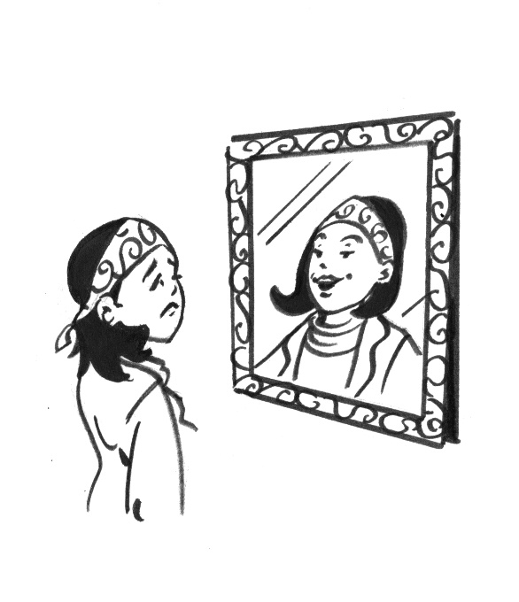
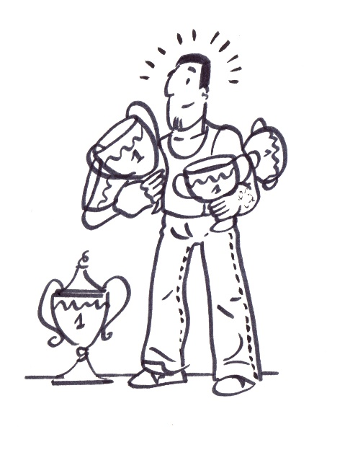
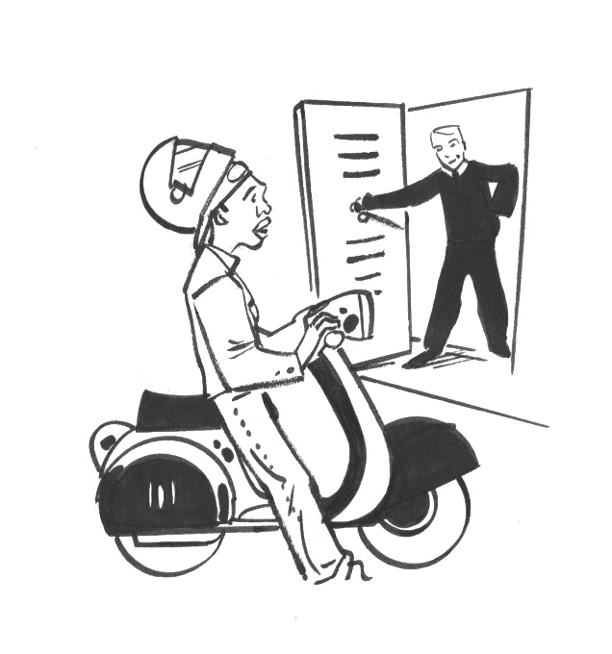
Personal background
Anna is not too much self confident, though the is a good student, she is able of making efforts and she wants to be successful in what she undertakes
Kevin always dreamt himself as a successful football player … school is not too attractive to him.. nevertheless he is realistic and knows that this internship is a great chance for him
Martin is not yet very engaged in studying. He has a good nature, he likes spending time with his mates and living casually.

Slide 5
Some situations during the internship
Martin has to wear a kind of uniform (a black suit)
and help travellers finding places to visit or get a taxi, or whatever
Martin
Anna holds a strategic position at the desk, and she is worried both to please the clients and the managers. Sometimes she does not know what to do with unsatisfied clients and needs to get help
Anna
Kevin deals with technical aspects, but he also has to be in good relationship not only with his supervisor but also with the clients who complain about things that are not working well.
Kevin

Slide 6



Training elements during the internship
During the internship period, Martin, Anna and Kevin are following the hotel teamwork management program, which is for all employees. The hotel management thinks that a good spirit and a common concern for client management is necessary to have the hotel functioning well.
Kevin is also following an extra training in German
Anna and Martin are anxious to improve their skills in English by all means, which includes looking at self-training videos on the internet.
Cette photo par Auteur inconnu est soumise à la licence CC BY-SA

Slide 7
The competences already acquired before the mobility
Most of the competences acquired by the three youngsters before the mobility could be qualified as "vertical" competences linked with their future qualification.
They probably have at least some hints about "transversal" elements such as cultural awareness, language, curiosity, open-mindedness, sociability, etc. After all, they have agreed to do a mobility, and they have been "briefed" a bit by their teachers.

Slide 8
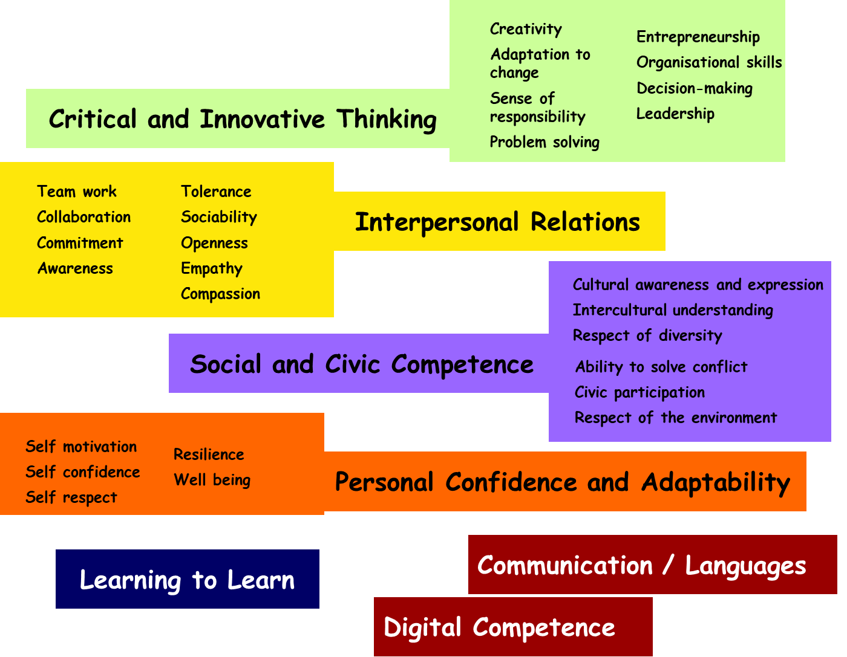
The elements of competenecs they are expected to acquire during the mobility
The Keymob competence model
The expected benefits:
Language (advanced)
Intercultural understanding (advanced)
Professional behaviour (advanced)
Client services (improved)
Team work (improved)

Slide 9
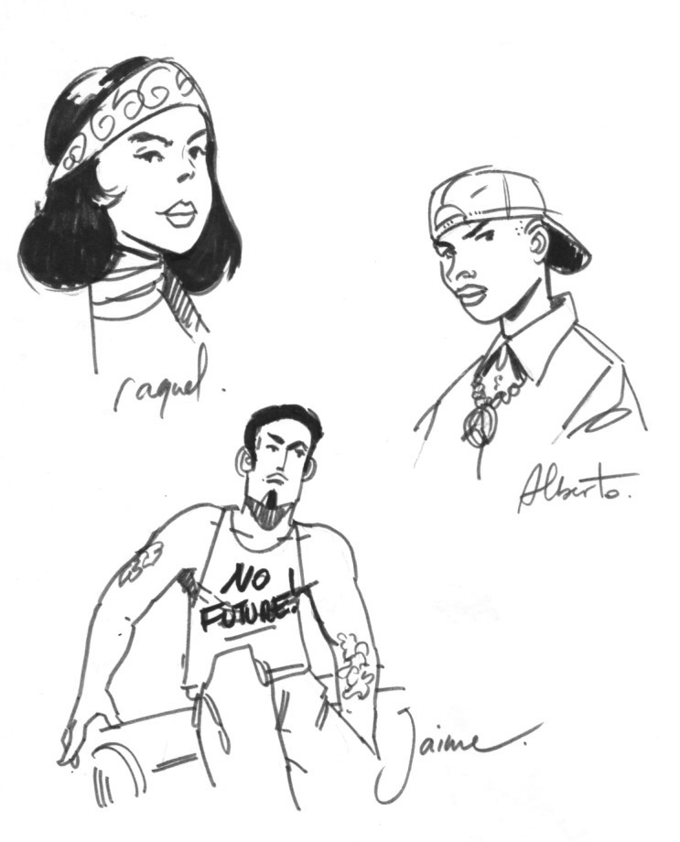
The competences they are practising during the mobility
Problem solving
Situation: Wifi is not functioning in the rooms
diagnostic (chamber, floor, hotel): client does not know how to use it!
communication, compassion, flexibility, sense of responsibility
Situation: Overbooking
Situation: Clients are asking for "good restaurants" address
patience,
analyse of the situation, communication, flexibility, collaborative work (find a solution together with clients),
decision-making.
search for information (colleagues, Internet),
critical thinking,
communication, intercultural understanding, self confidence.

Slide 10
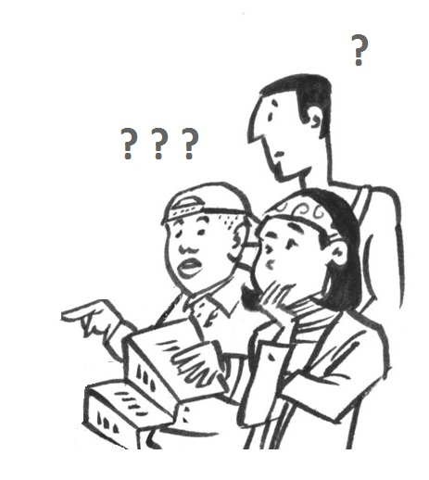
The competences they are practising during the mobility
Team work
Situation #1: organisation of a seminar for a group of clients
communication, time management, flexibility, intercultural understanding
mobilising the training programme from the hotel
Situation #2: flat-sharing
intercultural understanding
adaptability, flexibility
collaboration, problem solving

Slide 11

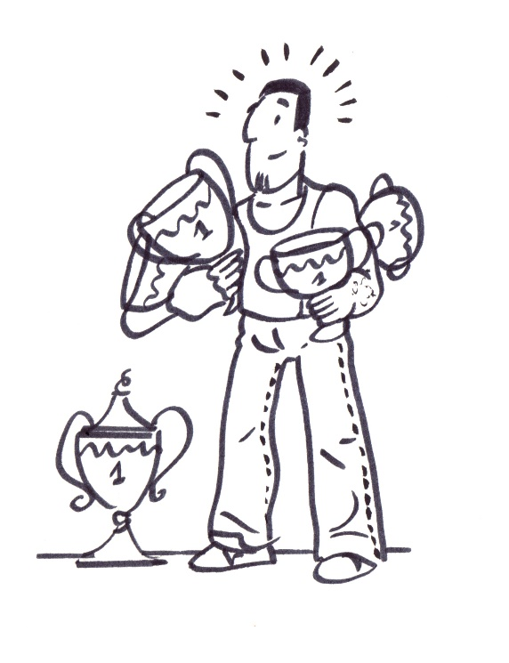
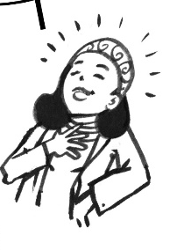
The competences they are practising during the mobility
Self confidence
Trainee of the week
Video for hotel promotion
be successful
overcome a problem
recognise what I am capable of, and my
limits
take action
be resilient
Most approved by clients

Slide 12
The learning outcomes they have eventually achieved at the end of the mobility
Critical and Innovative Thinking
Interpersonal Relations
Social and Civic Competence
Personal Confidence and Adaptability
Communication / Languages

Slide 13
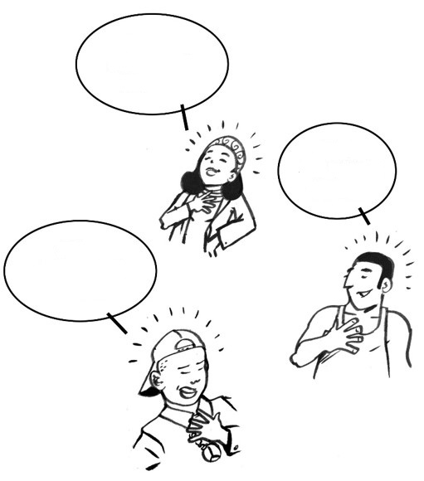
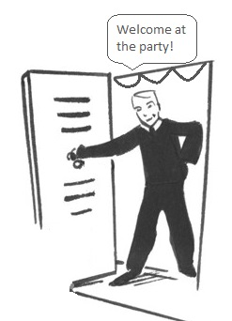
A collaborative self reflection process to help all actors recognising what they have learned
Situation #1: the three youngsters are celebrating the end of the mobility by partying at a friend’s place. They talk about their experience and realize what has changed for them.
Now I’m much more self confident!
I want to travel the world!
Before I didn't know what job I wanted to do
Learning to Learn

Slide 14
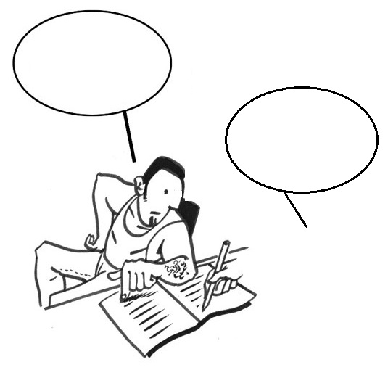
A collaborative self-reflection process to help all actors recognising what they have learned
Situation #2: after the mobility they also have an interview with the person in charge of the mobility in the sending institution
Learning to Learn
I’ve done…
…
Tell me about your experience…

Slide 15

Validating the competences at the end of the mobility
Individual report
Collective report
Assessment + appraisal report from the hotel
etc.
➔ Each schools finds corresponding Learning Outcomes in their Learning Programme and validate the equivalence in ECVeT.

Slide 16
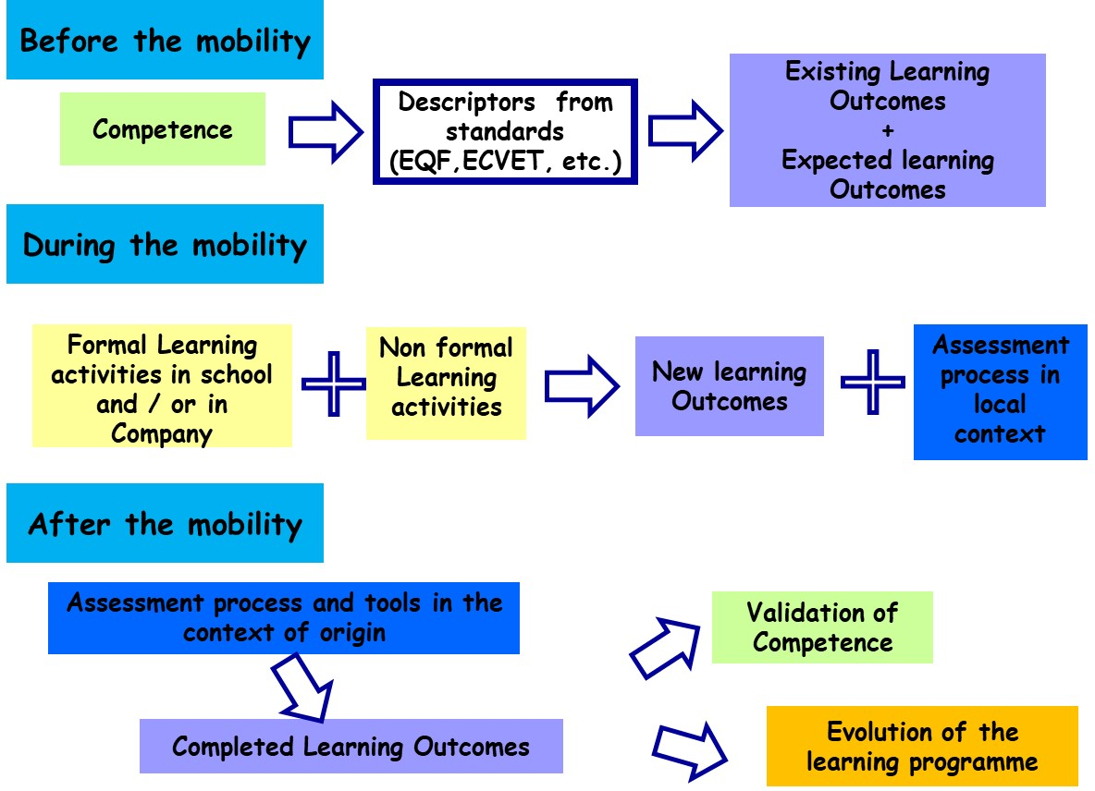
Validation of Competences acquired through mobility

Slide 17
Examples of how to integrate new Learning Outcomes in the different learning programs to better prepare students to a mobility
Introduce Learning Outcomes related to the Transversal Competences
  in specific activities: group work, case studies, role play games, etc.
  together with the vertical technical competences: awareness of situations
Introduce less formal Learning and Assessment situations
Some learning is anyway not well rendered in a curriculum description…even if a lot of things can be taught!

Slide 18
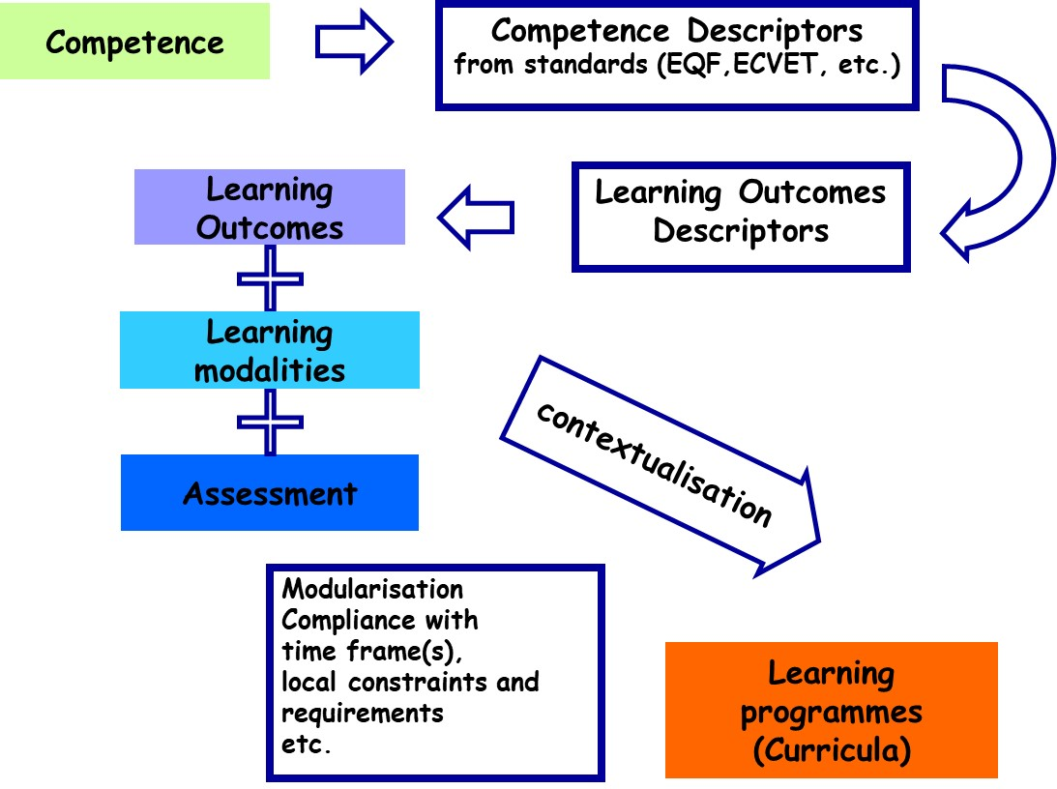
Methodology for building competence based Learning Programmes

Slide 19

Examples of how to enhance the curricula in the different schools to have further students better benefit from their mobility
Break down the curricula into more flexible Learning Units
Write directly the Learning Units in terms of Learning Outcomes, "compatible" with the European standards
Have the assessment processes evolve to take into account the achievement of Learning Outcomes
Keep in mind the interaction between the description of the competences, the learning outcomes and the assessment and validation process
The whole process is a virtuous spiral!

