Slide 1




Dissemination partner
@earlallEU
@EARLALL
@EARLALL

Slide 2

#keymob
  “Our greatest hopes could become reality in the future. With the technology at our disposal, the possibilities are unbounded. All we need to do is make sure we keep talking.”
  Stephen Hawking

Slide 3
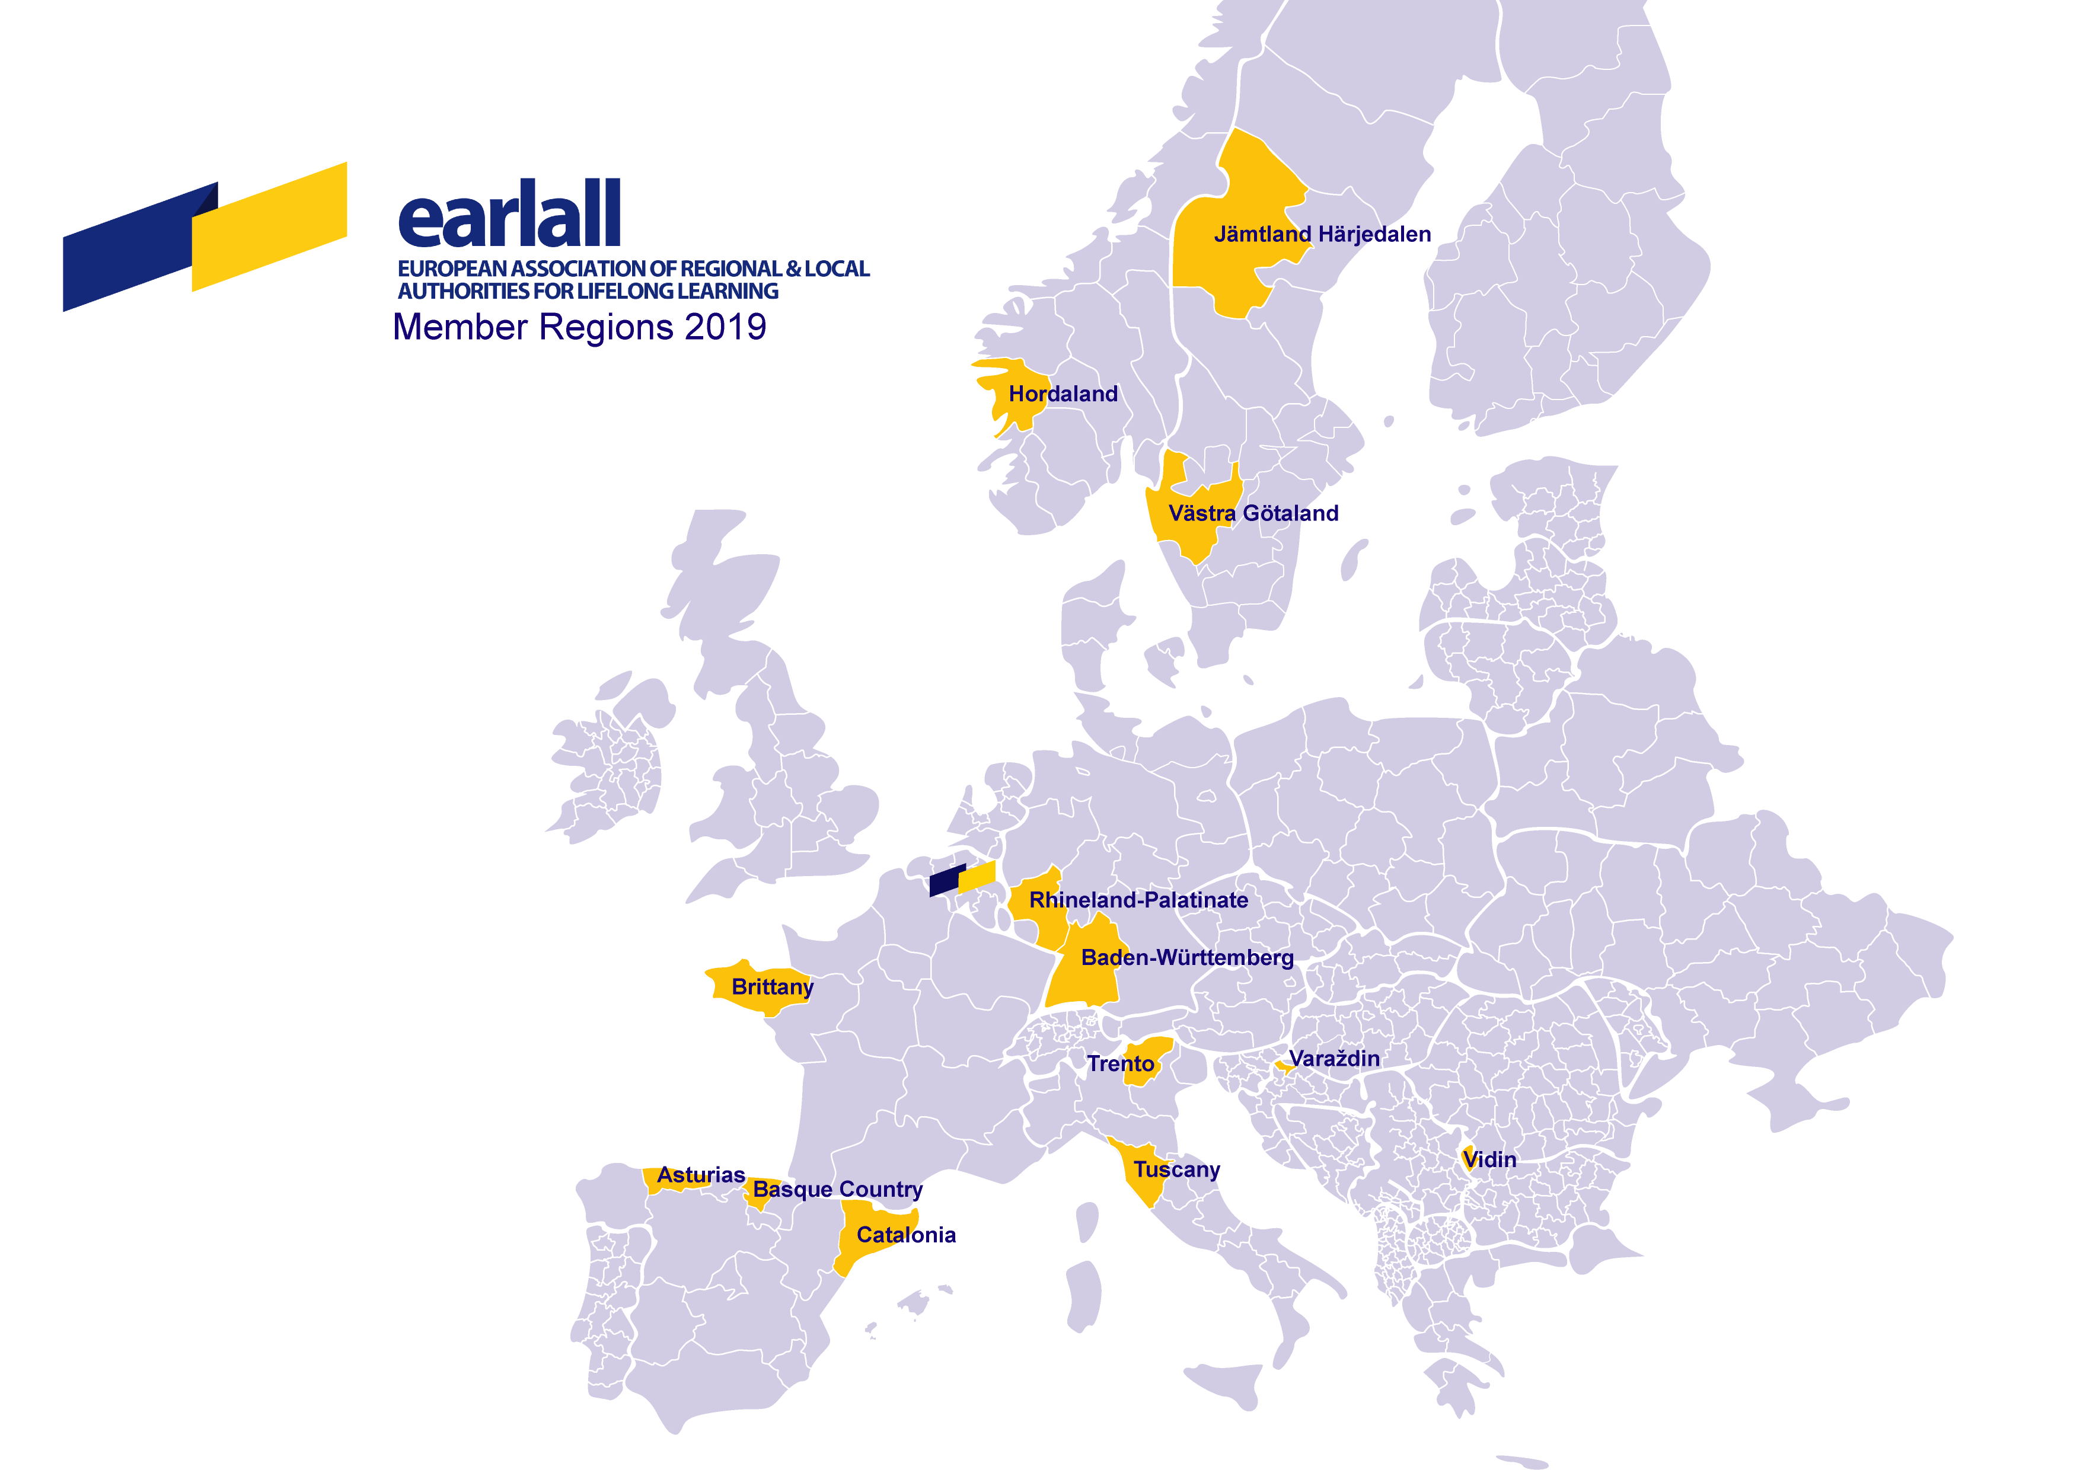














EARLALL: Members (2019)
Observers:

Slide 4



European Commission
Strengthening European Identity through Education and Culture (November 14, 2017)
Tibor Navracsics
Commissioner for Education, Culture, Youth and Sport, at the First European Education Summit (January 25, 2018)
“Competences for education and culture lay primarily with Member States at national, regional and local level.”
Proposal for a Council Recommendation on Key Competences for Lifelong Learning
“Education is key because it is education that equips us with the skills we need to become active members of our increasingly complex societies. It is education that helps us adapt to a rapidly changing world, to develop a European identity, to understand other cultures and to gain the new skills one needs in a society that is mobile, multicultural and increasingly digital.”
“Education and training are part of the solution to get more people into decent jobs, respond better to the skills the economy needs and strengthen Europe's resilience.”
“Lifelong learning offers a way for re-skilling and up-skilling […]. It is essential to seek convergence and increase the share of people engaging in learning throughout their lives. This would be a promising way to improve skills and knowledge capital in Europe.”

Slide 5

EARLALL
EARLALL – European Association of Regional and Local Authorities for Lifelong Learning – is an international non-profit association registered in Belgium and established in 2001 under the initiative of regional governments willing to build a solid cooperation in the field of lifelong learning.
Led by the Basque Government, it is managed by a Board and a General Assembly. Today, it represents 13 members/regional authorities and a group of observers, whose aims are to cooperate and raise the role and visibility of regional and local authorities in the field of lifelong learning at European and international level. The Secretariat is Brussels ensures the day-to-day management.
Members are actively involved in the life of the organisation through their participation in meetings, technical groups, thematic seminars and other events to take forward joint projects.
EARLALL believes that regions and local authorities have a privileged role in designing and implementing strategies on lifelong learning, since they are in direct contact with citizens, educational institutions and business environment.

Slide 6
EARLALL: Action Plan
Policy & advocacy – To position EARLALL and its members as a benchmark for lifelong learning expertise in the European arena, by means of bringing the regional perspectives to the European debate, policy shaping and implementation.
Antenna of opportunities and platform for exchange – To provide opportunities for EARLALL members to enhance their strategies, plans and actions, and to enable exchanges of good practices, experiences and expertise, seeking to facilitate concrete actions between members and other stakeholders, as well as participation in calls for proposals, tenders and initiatives by the EU.
Effective communication and dissemination – To publicize and showcase EARLALL’s voice and actions via a dynamic and interactive webpage and use of social media, and to provide regular, timely and relevant information to the members.
Governance & outcome and impact monitoring – To plan, budget and run general assemblies, seminars, and other internal meetings, as well as to monitor and assess the effectiveness and impact of the actions and deliverables by EARLALL.

Slide 7


Cooperation in EARLALL
Policy and Advocacy
  Engagement and participation in relevant events and cooperation with key partners
ReSET Network

Slide 8
Apprenticeship Support Services
The EAfA online library is now available! materials, practical tools and
guidance on apprenticeships. Useful resources include:
statistics overview of how many students participate in work-based IVET,
research paper on the topic of policy developments and practices of apprenticeship training in EU Member States.
Webinar on Apprenticeships systems in Europe
The webinar will take place on 23 July, 2019 at 10:00 AM CEST. Link to register
#DiscoverYourTalent
#EUVocationalSkills
EAfA meeting on the topic of Apprenticeships for adults,
15 October. The meeting will take place during European
Vocational Skills Week (Helsinki)

Slide 9


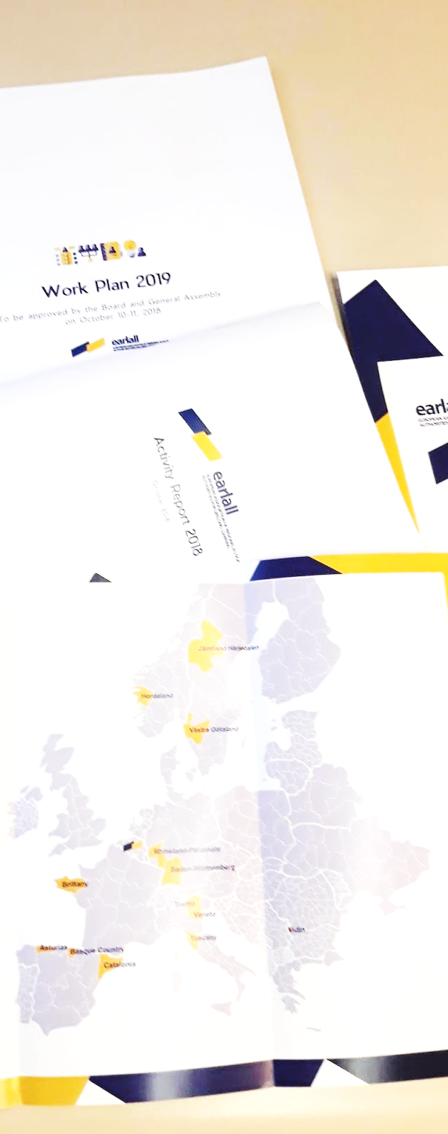



Cooperation in EARLALL
Effective communication and dissemination
EARLALL’s website and newsletters – Project updates and direct links to their websites through newsletters and the organization’s website.
2. Social media strategy – Twitter, Facebook and LinkedIn accounts managed by EARLALL Secretariat.
3. Events – Thematic conferences, multiplier events, international meetings, general assemblies, and participation in panels during high level forums.
www.earlall.eu
@EARLALLeu
EARLALL
EARLALL

Slide 10
Cooperation in EARLALL
An antenna of opportunities and a platform for exchange
  Thematic working groups dealing with selected matters and producing specific results:
Mobility in VET
Lifelong guidance
LLL and ageing population
Integration of migrants
Skills and labour market
Youth policies

Slide 11
Cooperation in EARLALL
An antenna of opportunities and a platform for exchange
  Enhancement of regional cooperation through funding opportunities, processes, projects and new alliances:
Ongoing
TALENTS (Erasmus+ KA2) - New talents for companies – Developing the potentials of immigrants and refugees | VET in Urban Centres (Erasmus+ KA2) - Development of sustainable urban centres with active involvement of vocational education and training (VET)
FIER (EaSI PROGRESS) - Fast-track Integration in European Regions | BRIDGE+ (Erasmus+ KA3) - Building up Regional Initiatives to Develop skills-based GuidancE: a digital multi-sector approach
KEYMOB (Erasmus+ KA2) – Key Competences for Mobility | BOOST to it! VET’s CLIL (Erasmus+ KA2) - Boost for Content and Language Integrated Learning in Vocational Education and Training

Slide 12
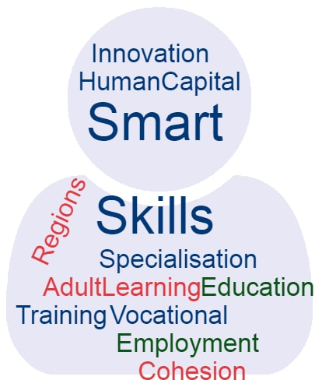
Cooperation in EARLALL
Governance and impact
Smart Specialisation Strategies
Skills Ecosystem
Learning Providers
Companies
Regional Authorities
The individual
© JRC European Commission
Regional Skills Ecosystems
Innovation (R&D, S3)
Growth
Sustainable Development
→ Social Dimension

Slide 13










Cooperation in EARLALL
Implementation
www.fierprojecteu.com | #FIERprojectEU
LEARNING
PROVIDERS
LEARNING
PROVIDERS
INDIVIDUAL
INDIVIDUAL
COMPANIES
COMPANIES
REGION
REGION

Slide 14
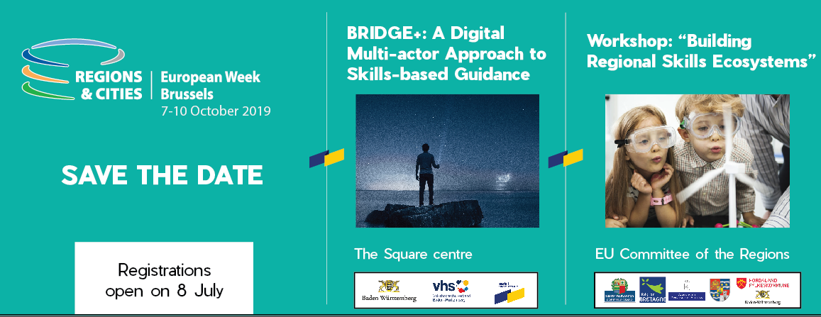
Cooperation in EARLALL
Upcoming Events
📅 27 September YES – Youth Entrepreneurship in Rural Areas
📅 7-10 October – EU Regions Week 2019
📅 19 November – FIER Conference
📅 27 November – Project Development Workshop

Slide 15
Dissemination Partner in Keymob
- Dissemination Plan & final multiplier event
Make sure results are in line with EC strategies
Project results to be considered at policy level
📅 SEE YOU IN SEPTEMBER 2020 IN BRUSSELS
FOLLOW US ON TWITTER
#keymob

Slide 16
Noelia Cantero
Business Manager
Noelia.cantero@earlall.eu
www.earlall.eu
@earlallEU
@EARLALL
@EARLALL
Delegation of the Basque Country to the EU
Rue des Deux Églises, 27 - 1000 Brussels (Belgium)
earlall@earlall.eu
Tel +32 (0)2 285 45 52 GSM +32 (0)484 18 64 75

